Slide 2
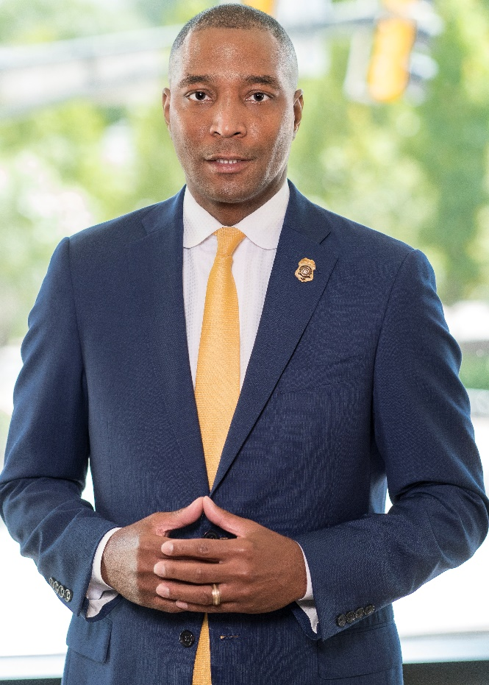
Overview
The Solicitor General’s office represents the State of Georgia in the Prosecution of misdemeanor and traffic offenses in Fulton county. The 40,000 cases prosecuted each year are handled by highly skilled prosecutors dedicated to the impartial and expeditious pursuit of Justice, public service and community outreach.
Keith E. Gammage
Solicitor-General

Slide 3
Office Focus Points: -Restorative Justice -Victim Empowerment -Offender Accountability

Slide 4
Restorative Justice
is the alternative to established criminal practices; it embraces the concept that victims, offenders and communities are critical stakeholders in the criminal justice process. To that end, we have implemented innovative projects and initiatives for the betterment of all stakeholders to make our communities safe.

Slide 5
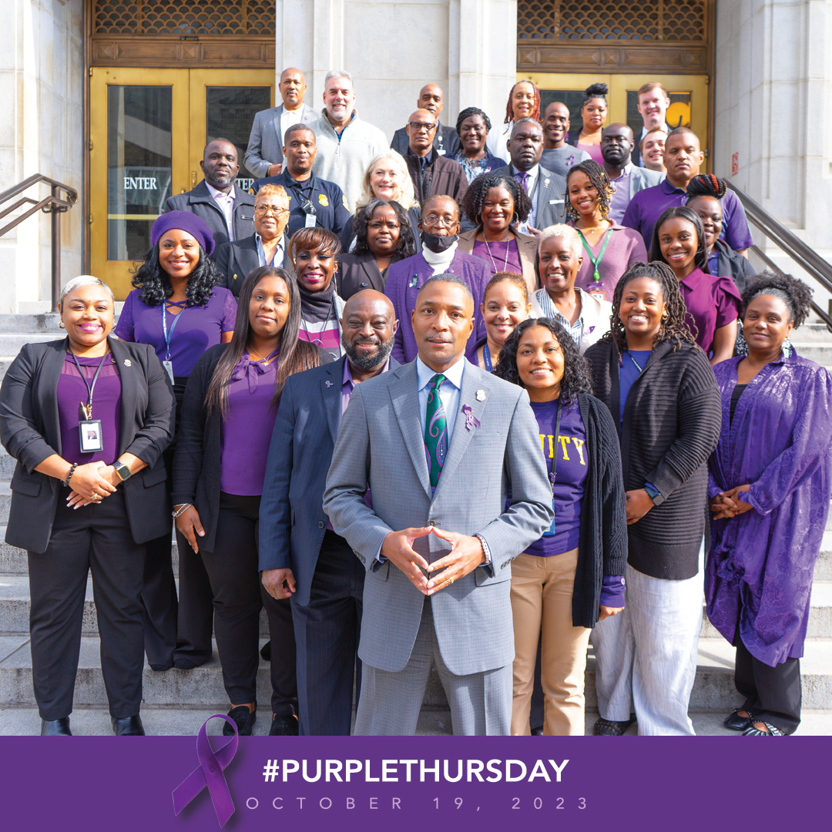
Victim Empowerment
Recognizing the unique needs of victims, our Victim-Witness Assistance Program (VWAP) ensures that the rights of victims are protected. The VWAP, staffed by Victim Advocates, focuses on supporting the needs of victims and reducing the trauma of crime.

Slide 6
Offender Accountability
University for Parents Diversion Initiative
offers second chance to low-risk offenders with children under the age of 19. The curriculum includes socioeconomics wellness, parenting skills, personal development and career readiness .
Record Restriction Summits
an offender re-entry initiative, restricts the criminal records of offenders providing a greater opportunity for obtaining housing and sustainable income.

