Slide 1

FINANCE DEPARTMENT

Slide 2
Fulton County
Citizens’ University
Finance Department
Budget vs. Actual Overview
Sabrinna McTier, CPA, CGFM
Budget Manager

Slide 3
FY 2023 Introduction to the Finance Department
Fulton County Finance Department is led by Director Hakeem Oshikoya, CPA, CGFM and Deputy Director Ray Turner, CPA. The department is composed of different units all of which perform different functions and responsibilities. The current units include
ACCOUNTS PAYABLE
  Vendor Payments & other financial services
ACCOUNTS RECEIVABLE/BUSINESS LICENSE
  Billing and collection of business license taxes
  Establishing a county-wide billing and collection function
ADMINISTRATION

Slide 4
FY 2023 Introduction to the Finance Department
Fulton County Finance Department is led by Director Hakeem Oshikoya, CPA, CGFM and Deputy Director Ray Turner, CPA. The department is composed of different units all of which perform different functions and responsibilities. The current units include
ACCOUNTS PAYABLE
  Vendor Payments & other financial services
ACCOUNTS RECEIVABLE/BUSINESS LICENSE
  Billing and collection of business license taxes
  Establishing a county-wide billing and collection function
ADMINISTRATION

Slide 5
FY 2023 Introduction to the Finance Department
Fulton County Finance Department is led by Director Hakeem Oshikoya, CPA, CGFM and Deputy Director Ray Turner, CPA. The department is composed of different units all of which perform different functions and responsibilities. The current units include
ACCOUNTS PAYABLE
  Vendor Payments & other financial services
ACCOUNTS RECEIVABLE/BUSINESS LICENSE
  Billing and collection of business license taxes
  Establishing a county-wide billing and collection function
ADMINISTRATION

Slide 6
FY 2023 Introduction to the Finance Department
BUDGET
  Development of the County’s budget.
  Responsible for monitoring the budget and controlling the budget
GENERAL ACCOUNTING
  Responsible for making sure all financial transactions are recorded properly and in a timely manner.
  Bank reconciliations, financial reporting, fixed assets, etc.
GRANTS ADMNISTRATION
  Responsible for ensuring the County’s financial processes related to federal, state and local grants comply with regulatory and compliance standards.

Slide 7
FY 2023 Introduction to the Finance Department
TREASURY/CASH MANAGEMENT
  Management of financial investments and retirement assets
  Collecting, receipting and depositing all County revenues
PAYROLL/EMPLOYEE BENEFITS
  Administration of employee benefits and payroll for active employees
RISK MANAGEMENT/WORKERS COMPENSATION
  Administration and management of County’s insurance and self-funded insurance programs
WATER AND SEWER OPERATION
  Billing and collection of water and sewer charges

Slide 8
FY 2023 Introduction to the Annual Budget
Budget Process begins in the summer of the prior year and concludes with the Proposed Budget presented to the BOC in November, public hearings in December and Final Adopted budget by BOC in January of applicable year.
Fulton County FY2019 budget totals $1.1 billion including $719 million for the General fund.
Appropriated Funds

Slide 9
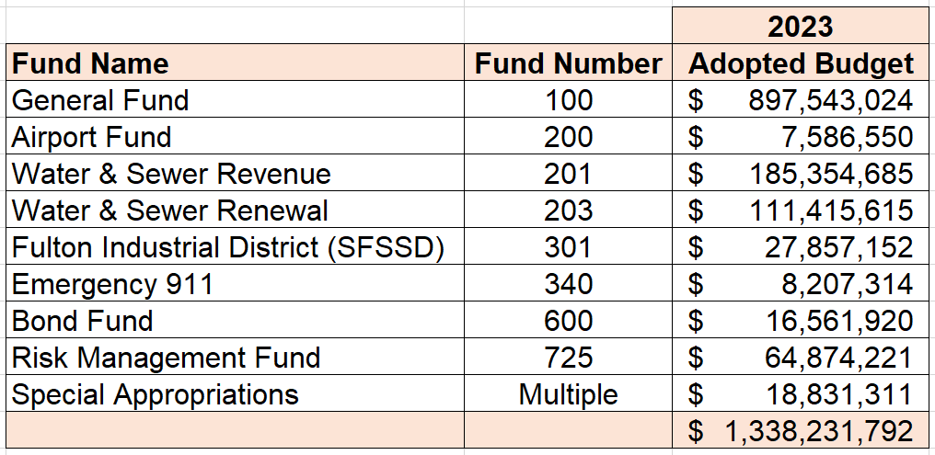
FY 2023 All Funds Investment

Slide 10
FY 2023 General Fund
Summary
The FY2023 General Fund budget is $857 million
Approximately $461 million allocated to personnel expenditures
Approximately $436 million allocated to other operating expenditures.
The General Fund FY2023 budget is balanced through a combination or revenue enhancements and expenditure reductions.
The budget is balanced with FY2023 revenue of $822.8 million, use of $74.7 million in fund balance from FY2022, FY2023 operating expenditures of $857 million. The ending Fund Balance for FY 2023 will be $149.6 million, or 16.67% of recurring costs.

Slide 11
FY2023 General Fund - Approved Budget
How Do We Pay For It?

Slide 12
FY2023 General Fund - Approved Budget
Revenue Sources

Slide 13
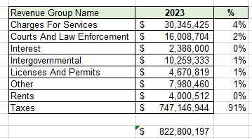
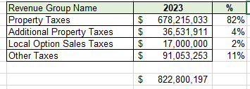
FY2023 General Fund - Approved Budget - Revenue

Slide 14
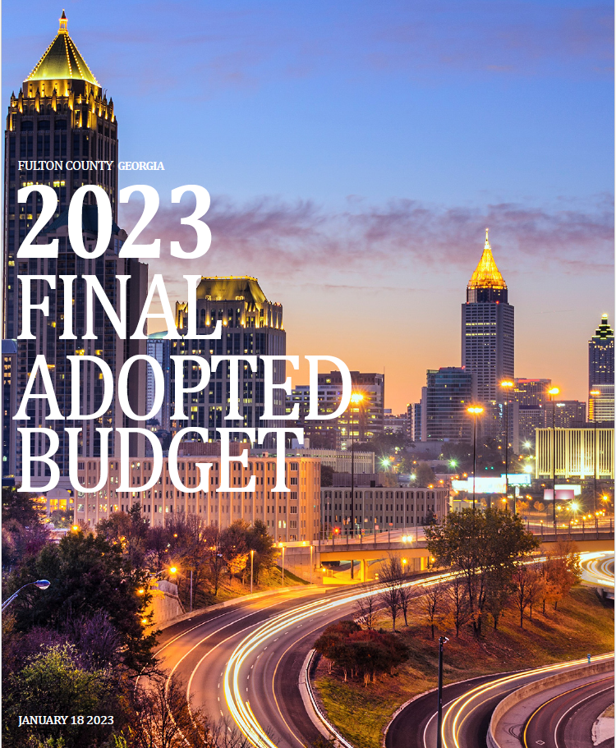
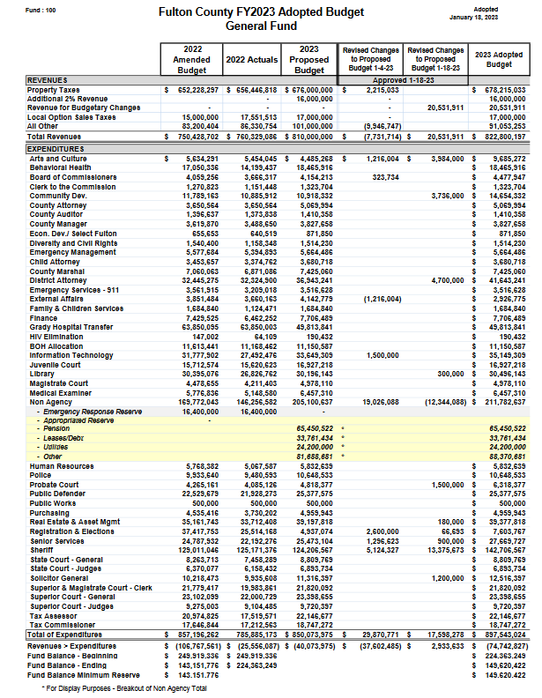
FY2023 General Fund - Approved Budget

Slide 15
FY2023 General Fund - Approved Budget
What is Fund Balance?

Slide 16
FY2023 General Fund - Approved Budget
Expenditures

Slide 17
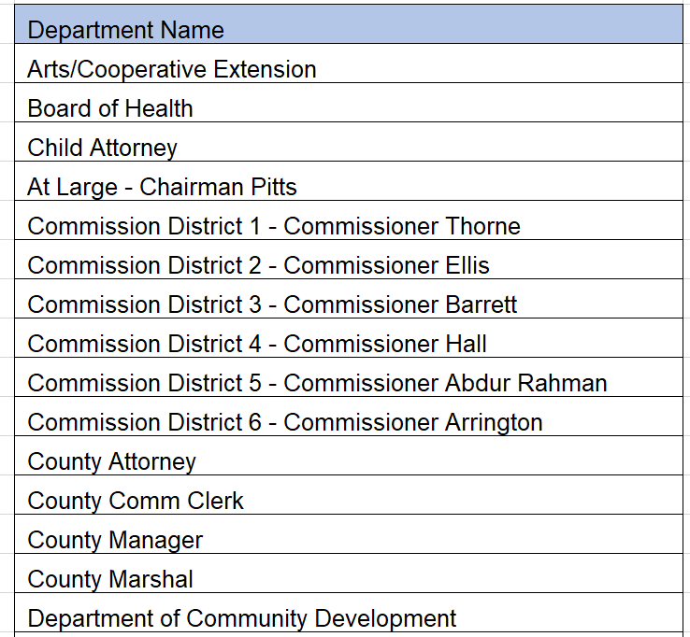
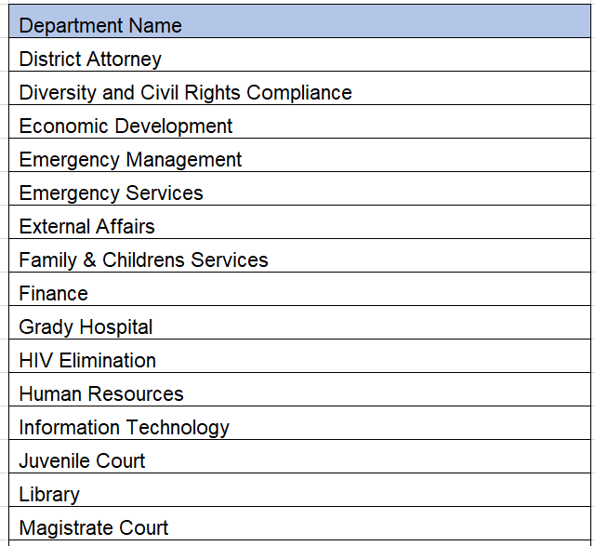
Departments within the General Fund

Slide 18
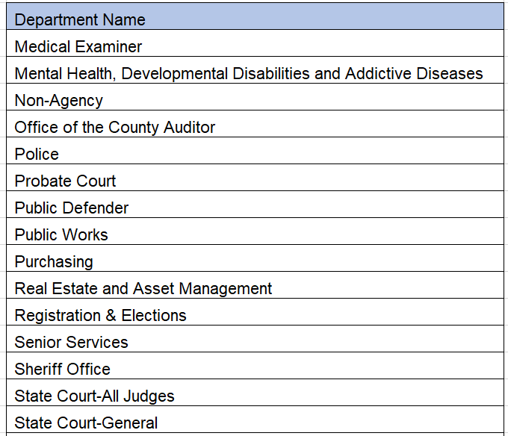
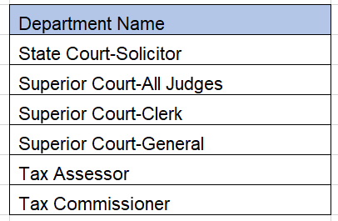
Departments within the General Fund

Slide 19
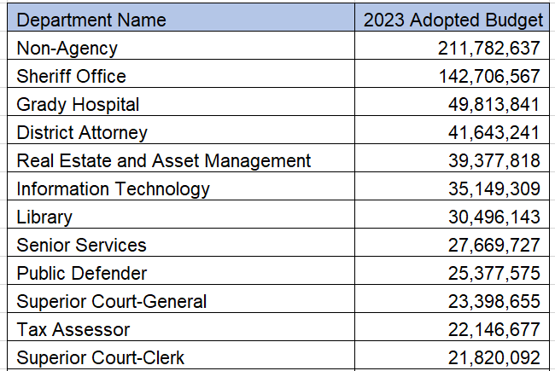
FY2023 General Fund - Approved Budget

Slide 20
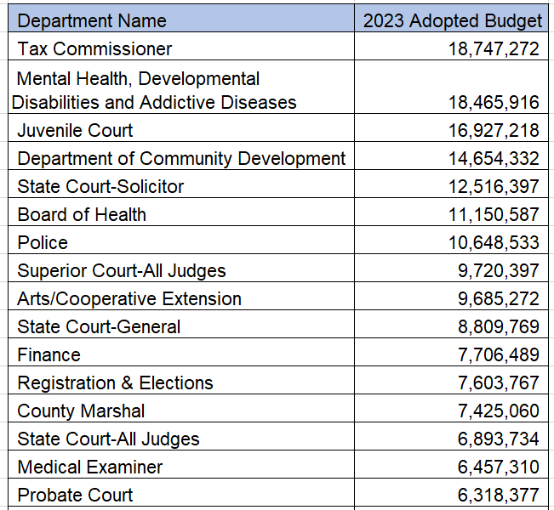
FY2023 General Fund - Approved Budget

Slide 21
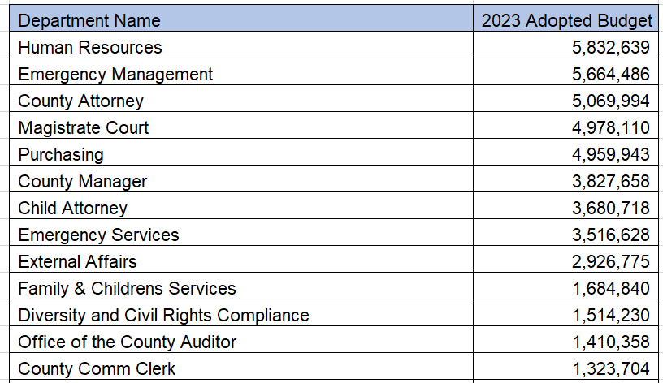
FY2023 General Fund - Approved Budget

Slide 22
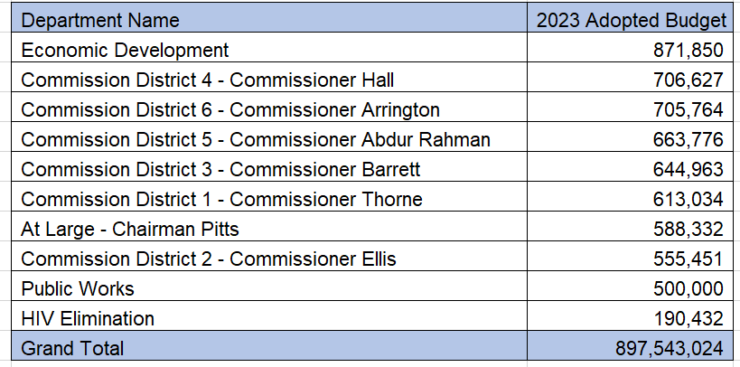
FY2023 General Fund - Approved Budget

Slide 23
FY2023 General Fund - Approved Budget

Slide 24
FY2023 General Fund - Approved Budget
Expenditures by Strategic Priority

Slide 25
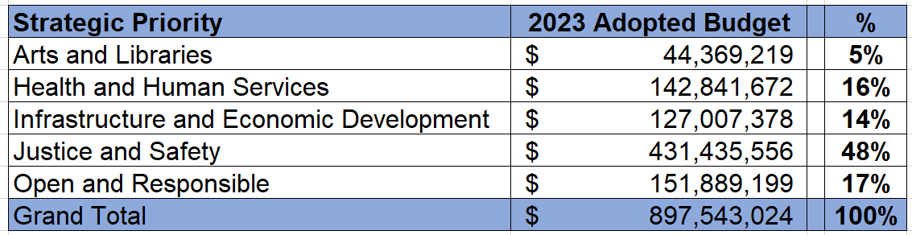
FY2023 General Fund - Approved Budget

Slide 26
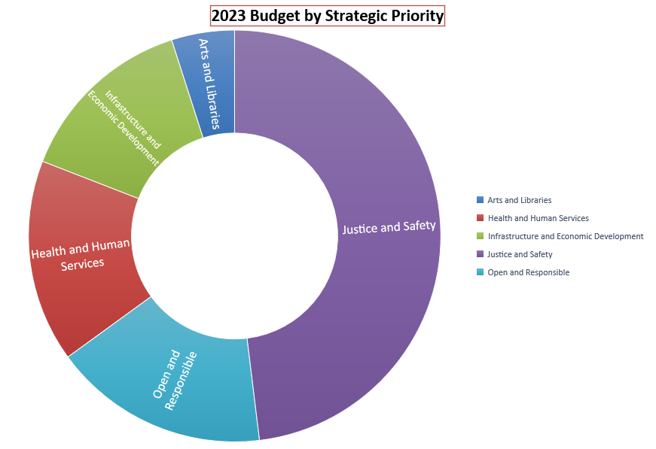
FY2023 General Fund - Approved Budget

Slide 27
FY2023 General Fund
Summary
The FY2023 General Fund budget is $897 million
Approximately $396 million allocated to personnel expenditures
Approximately $323 million allocated to other operating expenditures.

Slide 28
Budget vs. Actual
Looking Ahead
Approved Budget - 2023 Budget Book
Current
Budget vs. Actual Spending –On Demand/Monthly Financial Reports
Looking Back
Recap of Actual Spending
Annual Comprehensive Financial Report (ACFR)

Slide 29
Looking Ahead – 2023 Budget Book
https://www.fultoncountyga.gov/inside-fulton-county/open-government/budget

Slide 30
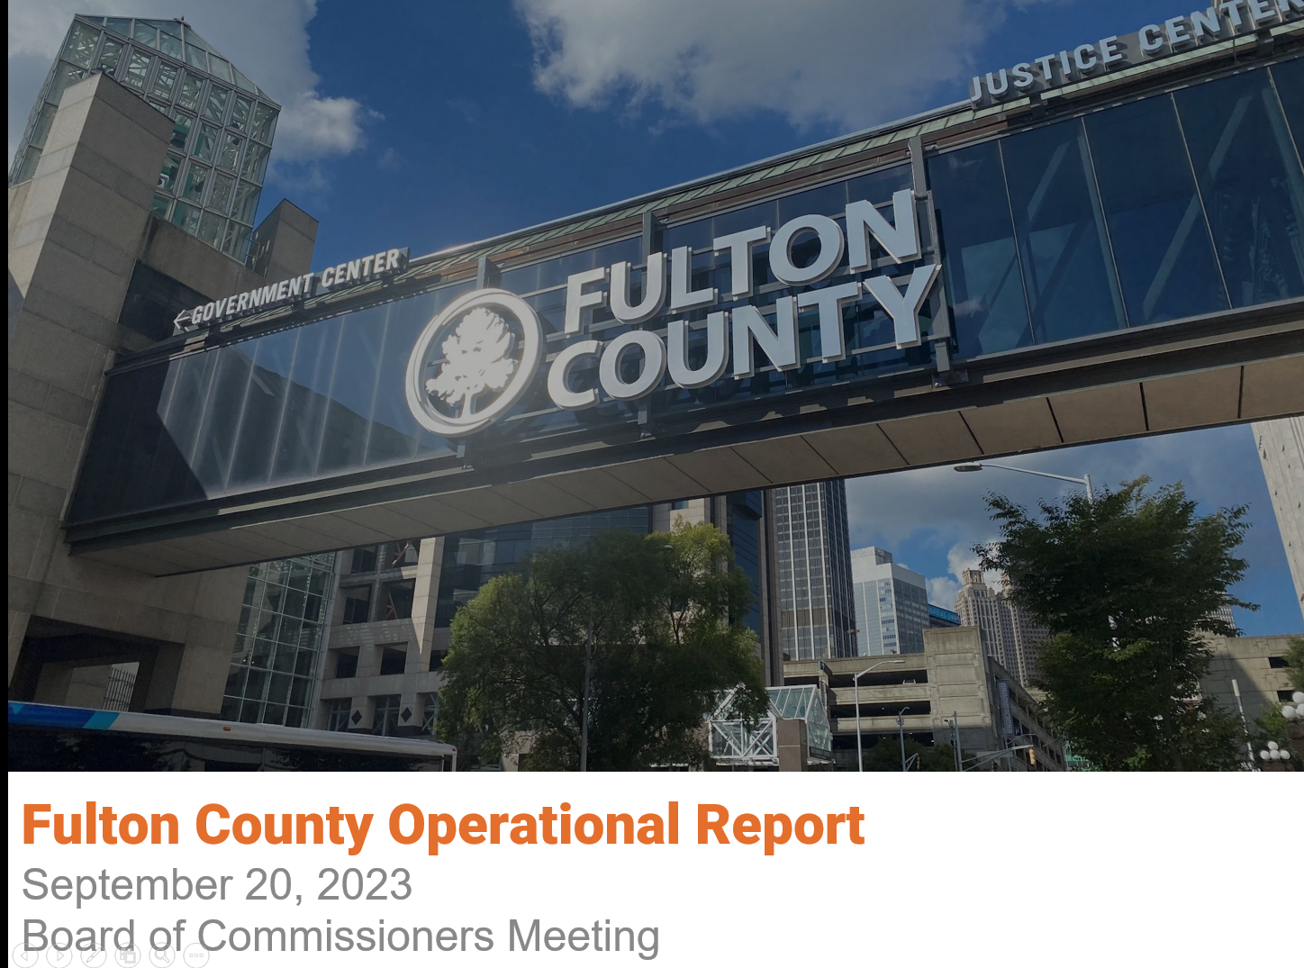

Current - Budget vs. Actual

Slide 31
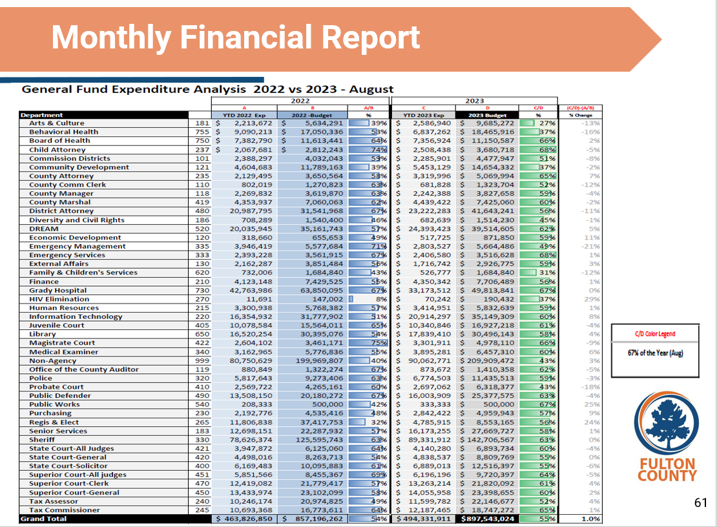
Current - Budget vs. Actual

Slide 32
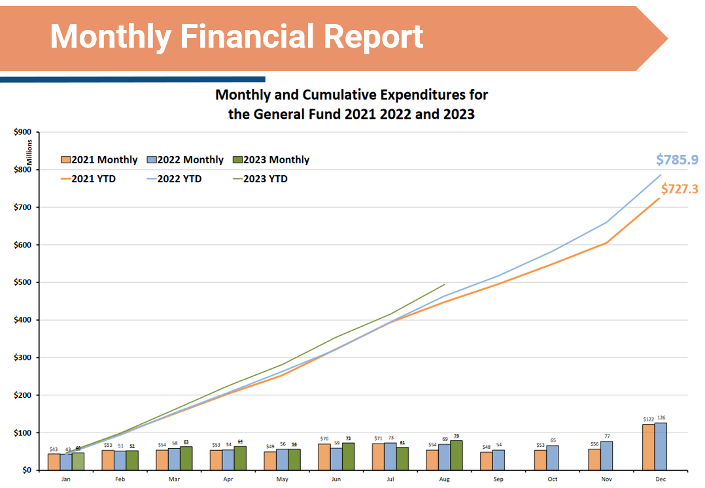
Current - Budget vs. Actual

Slide 33
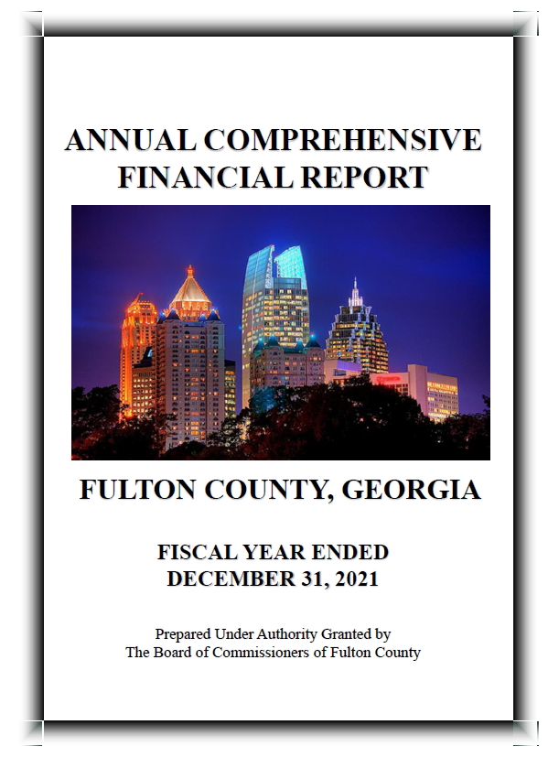
Looking Back –Annual Comprehensive Financial Report
http://www.fultoncountyga.gov/transparency

Slide 34
Approved Budget – How Do We Spend It?
What steps do we take to spend the Budget?

Slide 35
Personnel Expenditures
Departments - Human Resources - Finance – Payroll
Bi-weekly Pay Periods (Wednesday – Tuesday)
Pay Day – Every other Friday
35

Slide 36


How Do We Spend the Budget?
Personnel Expenditures Employees
36

Slide 37
FY 2023 General Fund - Approved Budget
Operating Expenditures
Departments - Purchasing- Finance – Accounts Payable
37

Slide 38
Operating Expenditures
Professional Services
Office Supplies
Postage
Risk Premiums
Hospitality
Memberships
Advertising
Computers
Travel/Training
Furniture, etc.
38

Slide 39
Operating Expenditures
Procurement Process
Manual Process
Credit Cards
39

Slide 40
Operating Expenditures
Procurement Process
Department of Purchasing and Contract Compliance
(bids, solicitations, purchase orders competition $4,999+)
Manual Process
Department and Finance – Accounts Payable
(payment vouchers)
Credit Cards
(small purchases $2,499 and under)
Purchasing card (PCARD) and Travel card (TCARD)
40

Slide 41

Finance Department Overview
Operating Expenditures –
Vendors
41

Slide 42
Engaged Citizens
Where Can I Find This Information?
https://www.fultoncountyga.gov/inside-fulton-county/open-government
42

Slide 43
Current - Budget vs. Actual

Slide 44
Current - Budget vs. Actual

Slide 45
Current - Budget vs. Actual

Slide 46
Looking Back –Annual Comprehensive Financial Report
http://www.fultoncountyga.gov/transparency

Slide 47
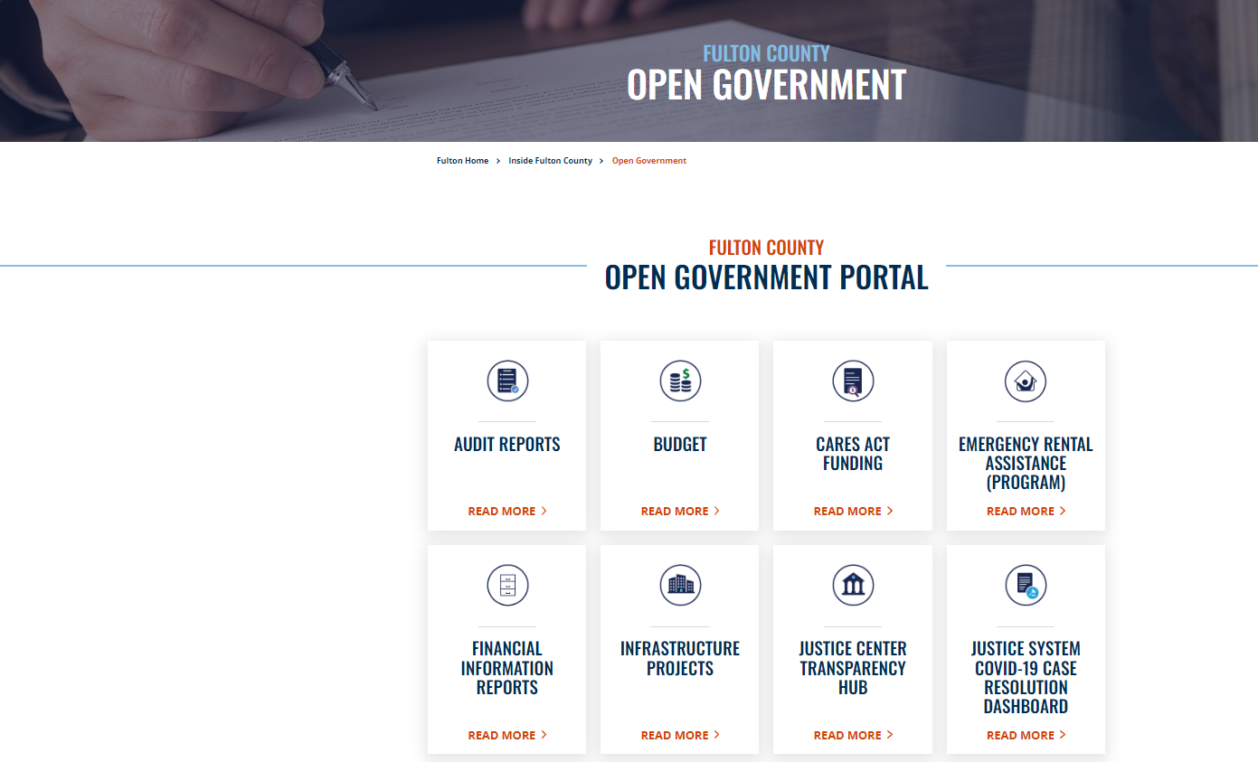
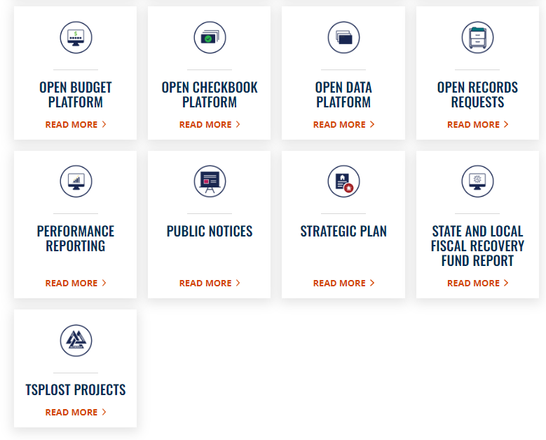
FY 2023 Introduction to the Annual Budget

Slide 48
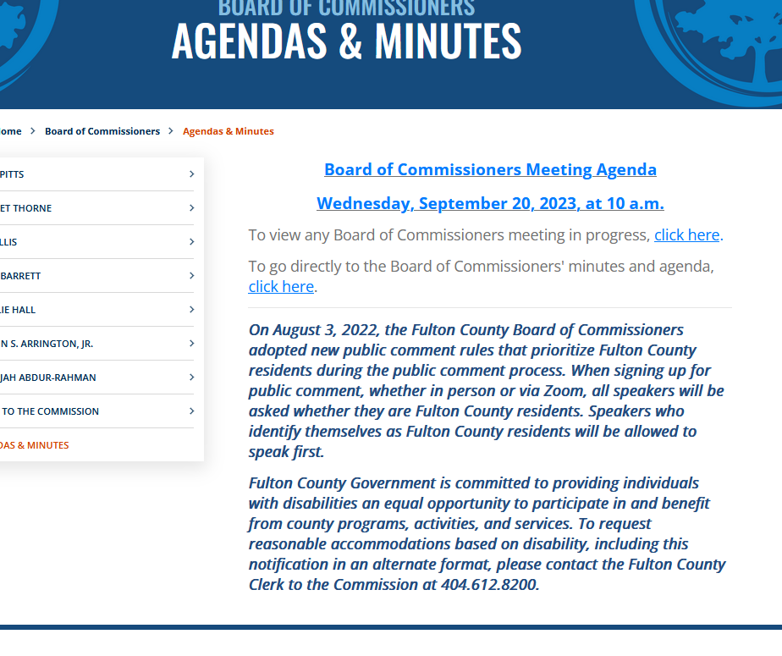
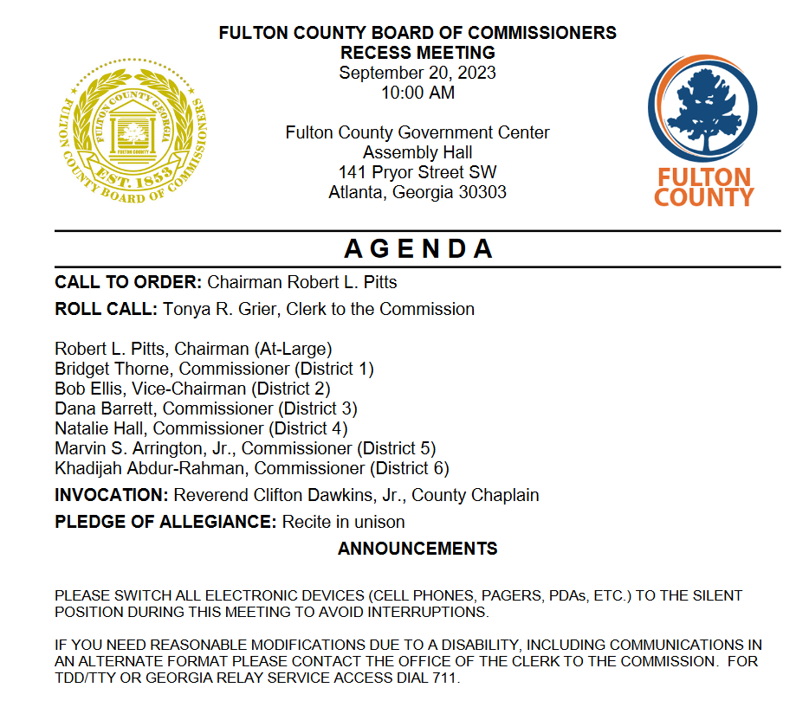
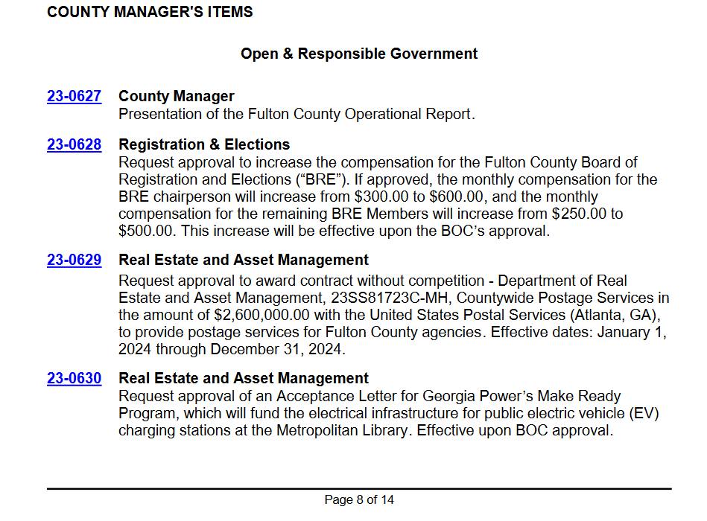
Engaged Citizens
48

Slide 49
Current - Budget vs. Actual

Slide 50
Current - Budget vs. Actual

Slide 51
Current - Budget vs. Actual

Slide 52
Engaged Citizens
Where Can I Find This Information?
52

Slide 53
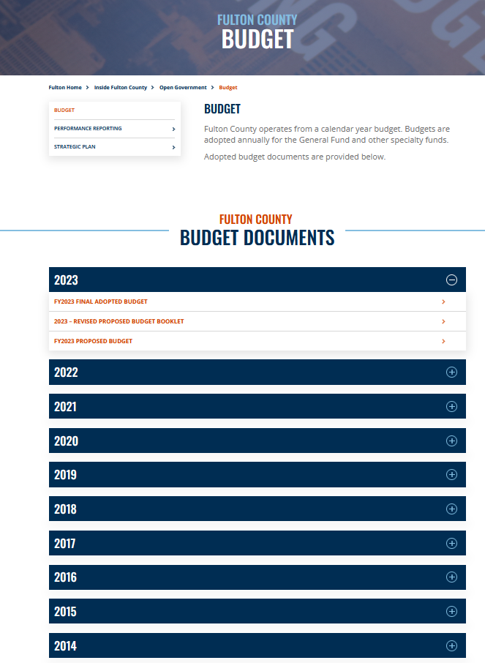
Looking Ahead – 2023 Budget Book
53

Slide 54
Looking Back –Annual Comprehensive Financial Report
http://www.fultoncountyga.gov/transparency

Slide 55
Engaged Citizens
Where Can I Find This Information?
55

Slide 56
Engaged Citizens – Socrata – Open Government

Slide 57
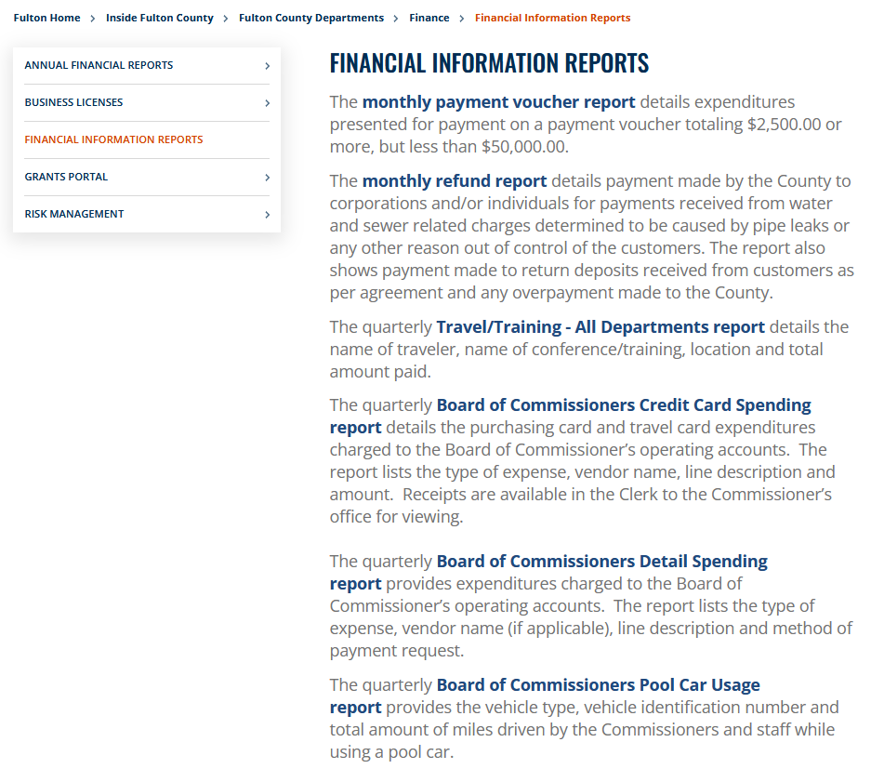
Engaged Citizens – Socrata – Open Government

Slide 58
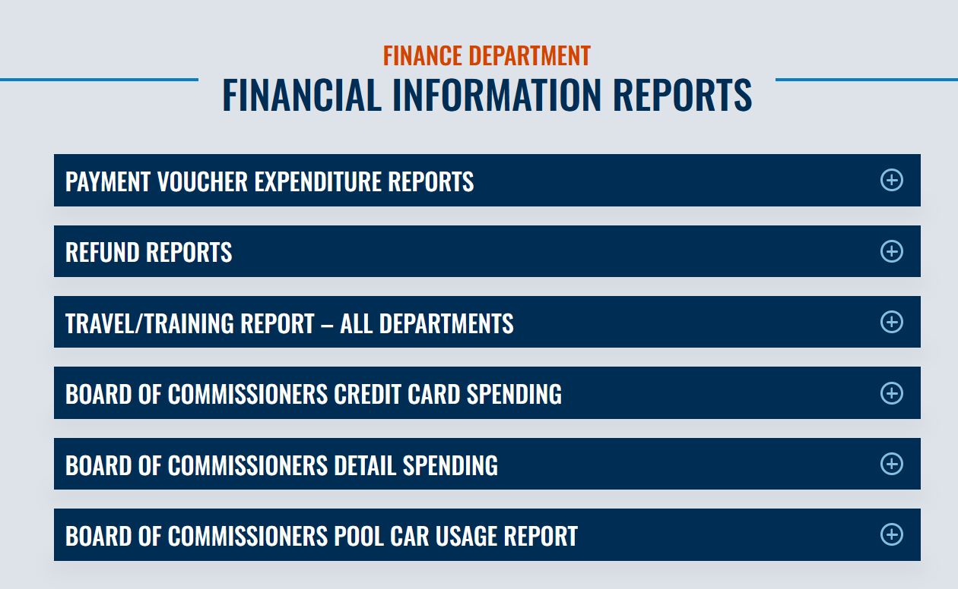
Engaged Citizens – Socrata – Open Government

Slide 59
Engaged Citizens – Socrata – Open Government

Slide 60
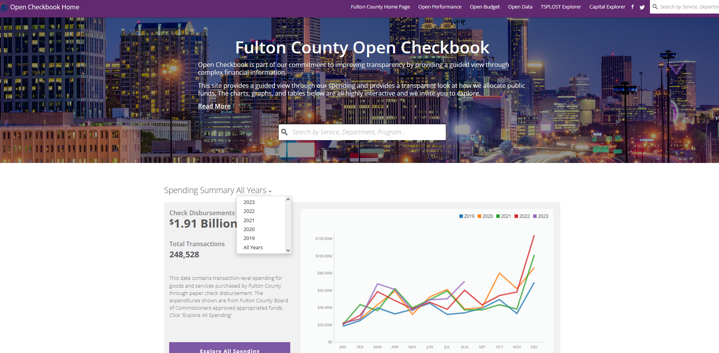
Engaged Citizens – Socrata – Open Checkbook
60

Slide 61

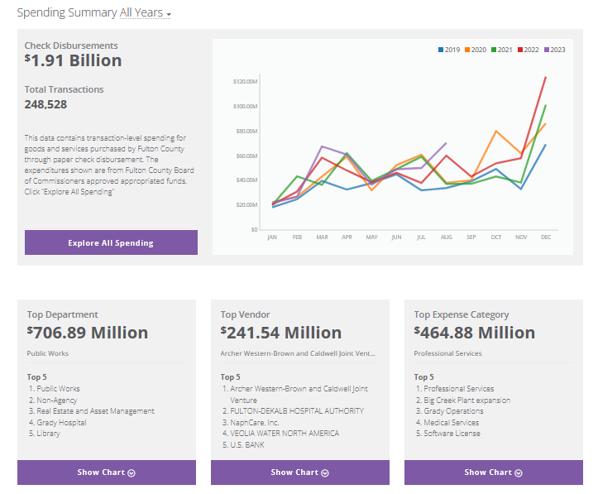
Engaged Citizens
61

Slide 62
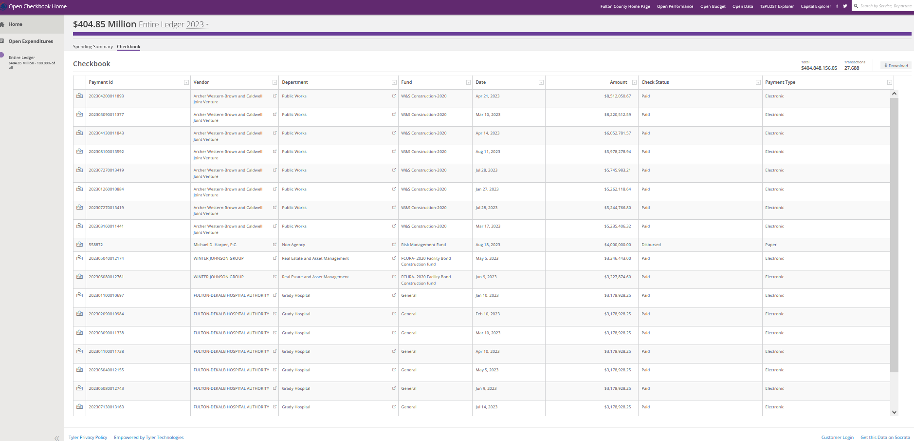
Engaged Citizens
62

Slide 63
Engaged Citizens – Socrata – Open Government

Slide 64
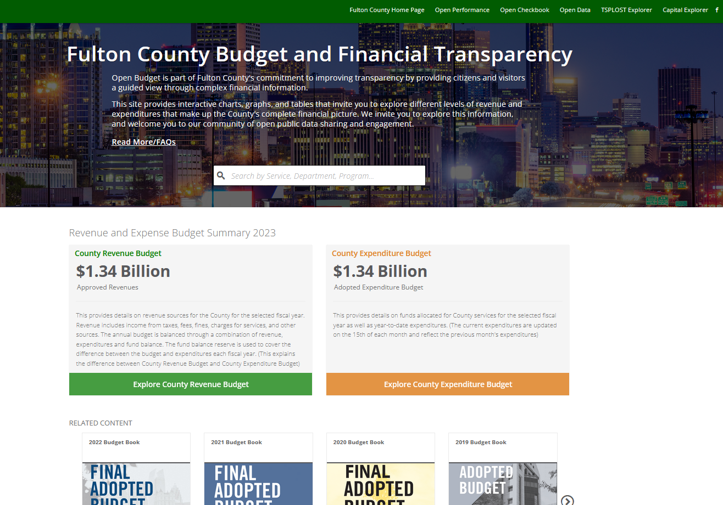
Engaged Citizens – Socrata – Open Government

Slide 65

Engaged Citizens
Thank You for being an engaged Citizen and Participating in Citizens’ University!

Slide 66
Fulton County
Citizens’ University
Finance Department
Budget vs. Actual Overview
Sabrinna McTier, CPA, CGFM
Budget Manager

