Slide 1
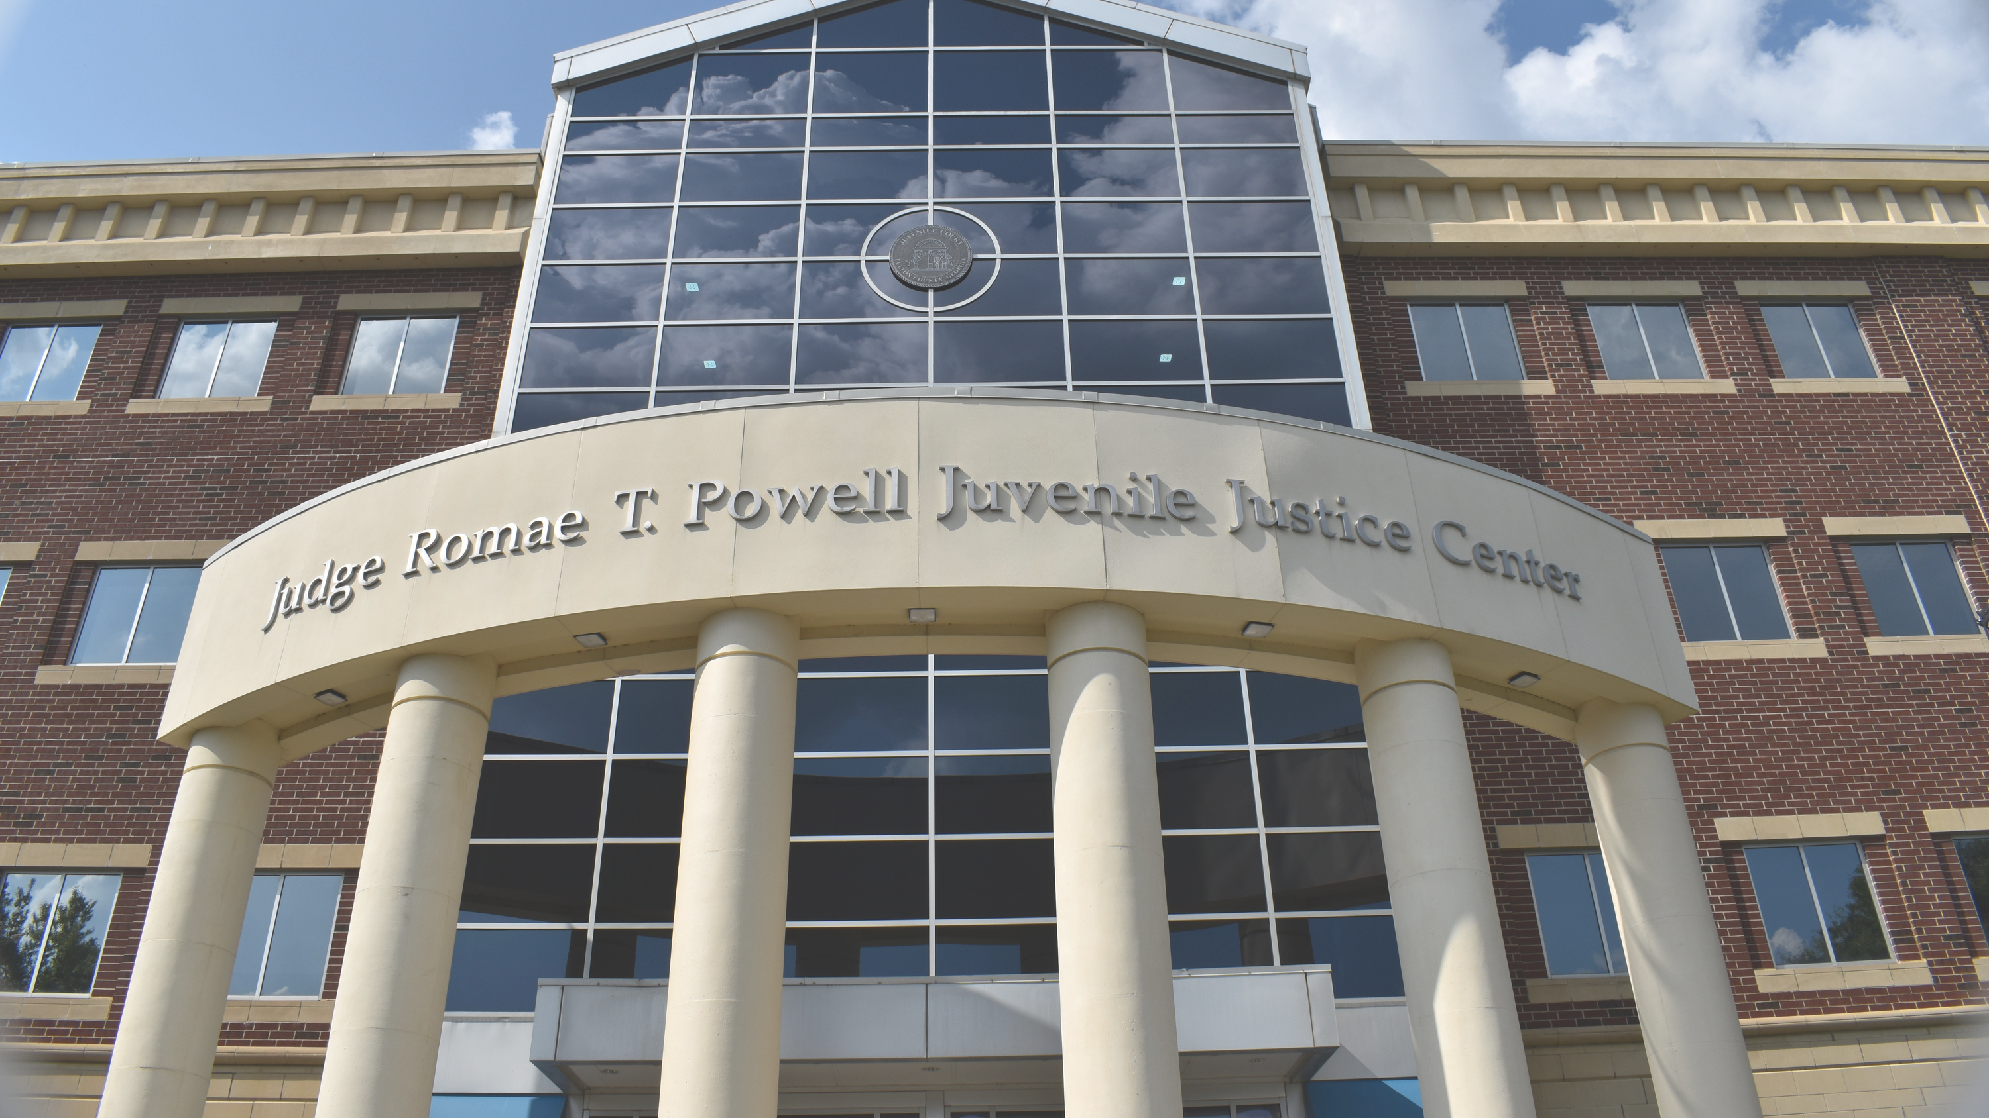
FULTON COUNTY
JUVENILE COURT
Cicely Barber
Chief Administrative Officer

Slide 2
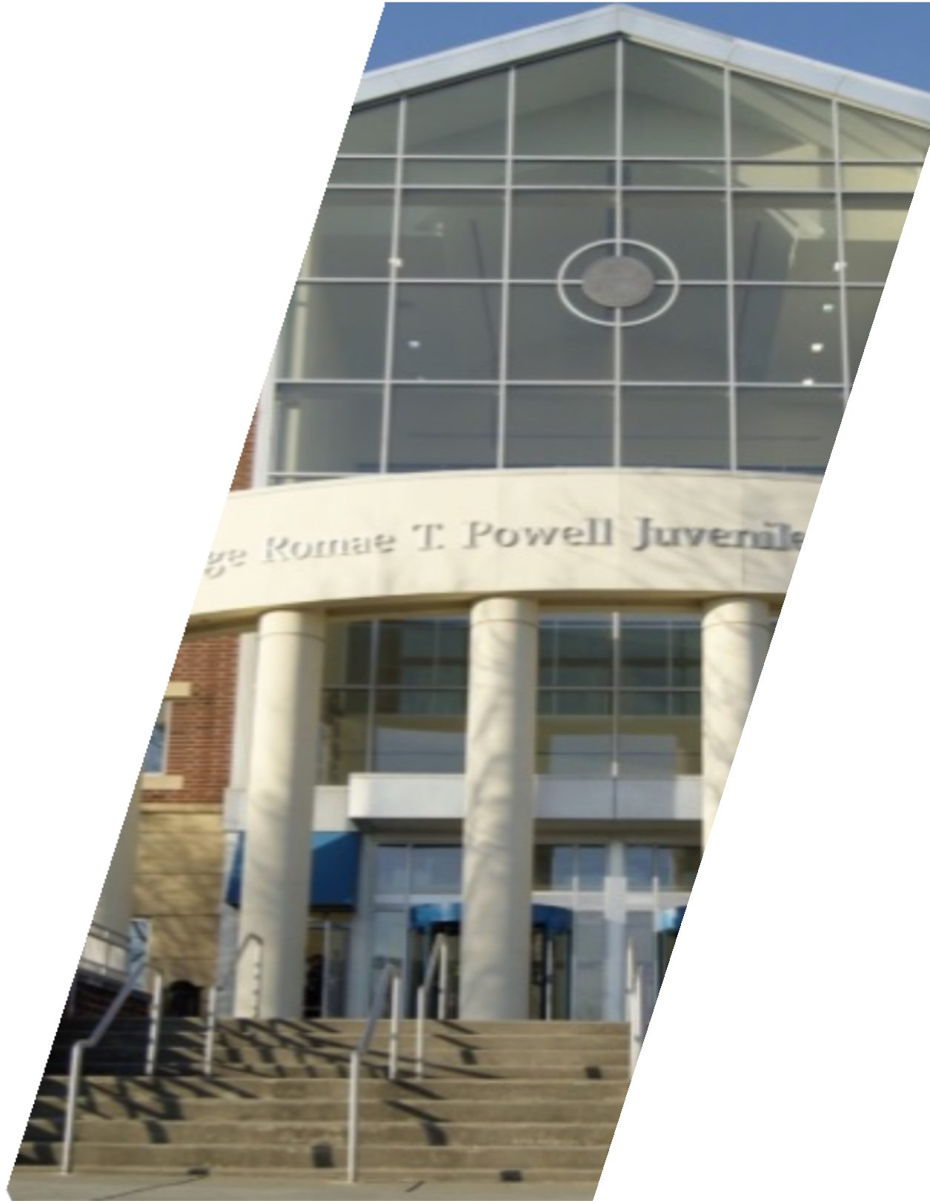
ABOUT US
Fulton County Juvenile Court is the largest juvenile court in Georgia and among the largest in the Southeastern United States.

Slide 3
Types of Cases
Dependency allegations for youth under the age of 18.
Children in Need of Services for youth under the age of 18.
Traffic Violations for youth under the age of 17.
Delinquent matters for youth under the age of 17.

Slide 4
Dependency
A dependent child is one who is neglected, abused, or abandoned. This can happen when the child does not receive proper parental care or control, education as required by law, or other care or control necessary for the child’s physical mental, or emotional health.

Slide 5
Delinquency
When a child violates a law that would be a crime if committed by an adult. A delinquent child is one who has committed a delinquent act and needs treatment and rehabilitation or supervision by the court.

Slide 6
Vision
To empower children and families by providing a fair, effective, and timely system of justice.

Slide 7
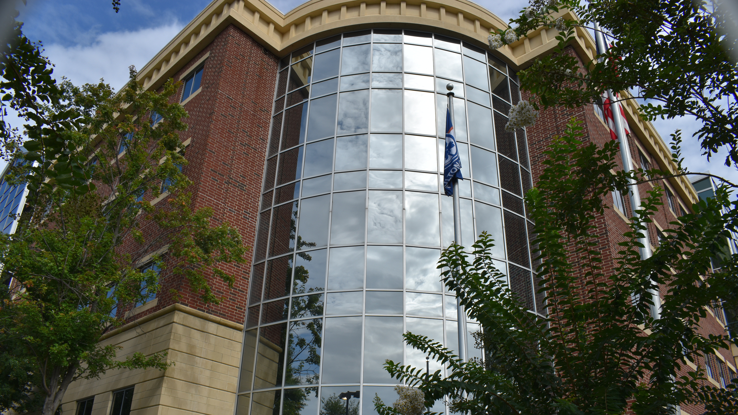
The mission of Fulton County Juvenile Court is: first, to protect children and the community in matters brought before the court, to rehabilitate children, and to restore families; and second, to create opportunities for the community, partners, and stakeholders to actively engage in this mission.

Slide 8
Court Motto
“One Court, One Family, One Community,” means that one Judge is assigned to all court matters involving a particular family. This is an approach that allows continuity in case handling because one Judge builds rapport with the family and has comprehensive knowledge of all matters that may affect the family, therefore, giving a more holistic response to family issues.

Slide 9
Core Values
R
Respect
Accountability
A
T
Transparency
Service
S
I
Integrity
Fairness
F
TI
Trauma Informed

Slide 10
Guiding Principles
01
Protecting and Guiding Children
02
Protecting the Community
03
Rehabilitating Children
04
Empowering and Restoring Families
05
Engaging Stakeholders and Community

Slide 11
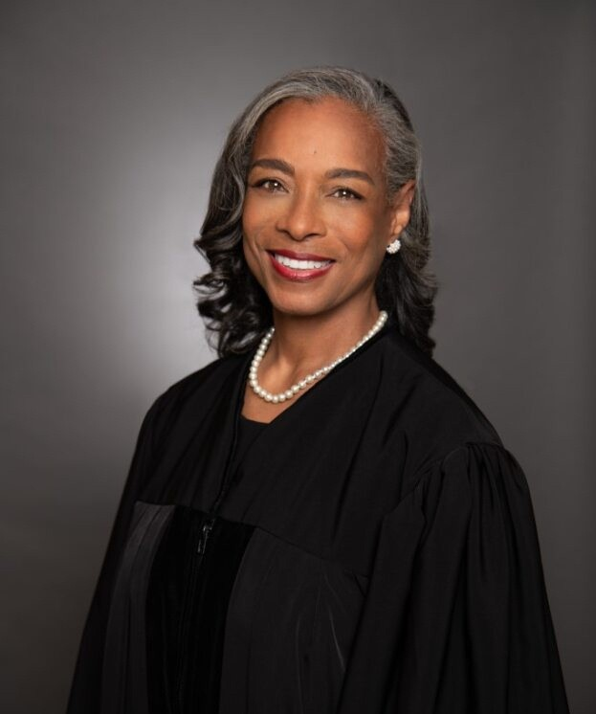
Judge Juliette W. Scales
Chief Presiding Judge
Judge Scales leads the judiciary and directs the operations of Fulton County Juvenile Court. Judge Scales has served on the court since 2013 and was designated as the Chief Presiding Judge in January of 2018.

Slide 12
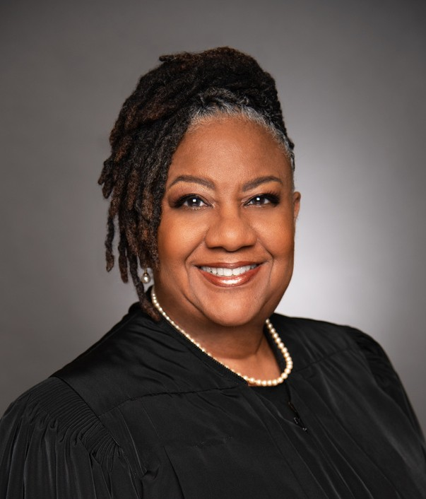
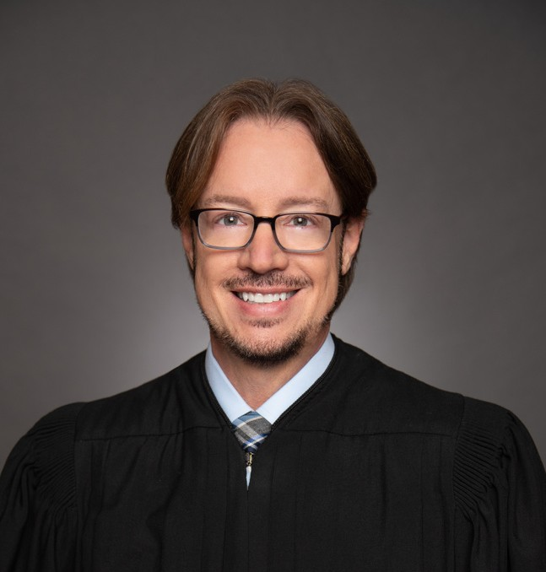
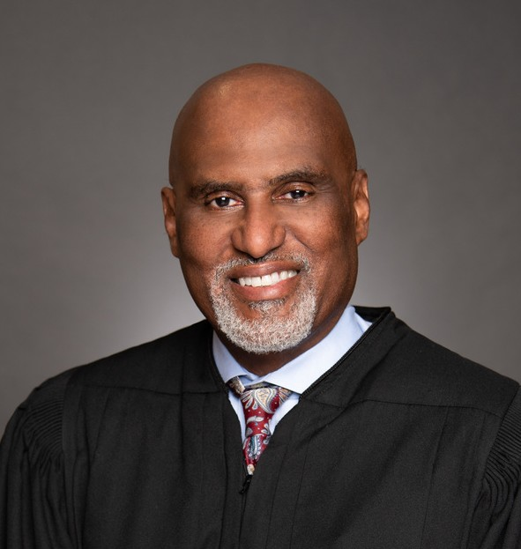
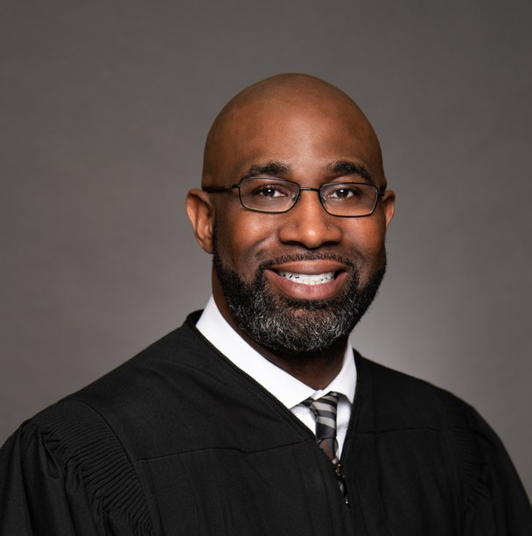
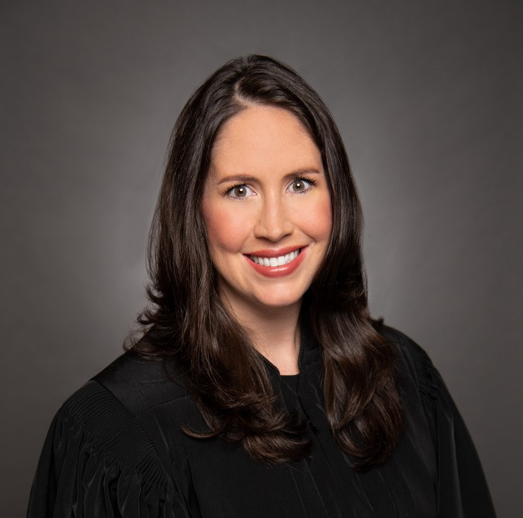
The Judiciary
Under the leadership of Judge Scales, there are currently five Presiding Judges at Fulton County Juvenile Court.
Renata D. Turner
Christopher W. Yokom
Phillip Jackson
Coy Johnson, Jr.
T. Natasha Crawford

Slide 13
Divisions
Clerk’s Office
Programming & Grants
Court & Family Services
Behavioral Health Services
Probation

Slide 14
Clerk’s Office
The Clerk’s Office functions as the recordkeeper of official court records. They are responsible for all administrative processes surrounding courtroom documentation.

Slide 15
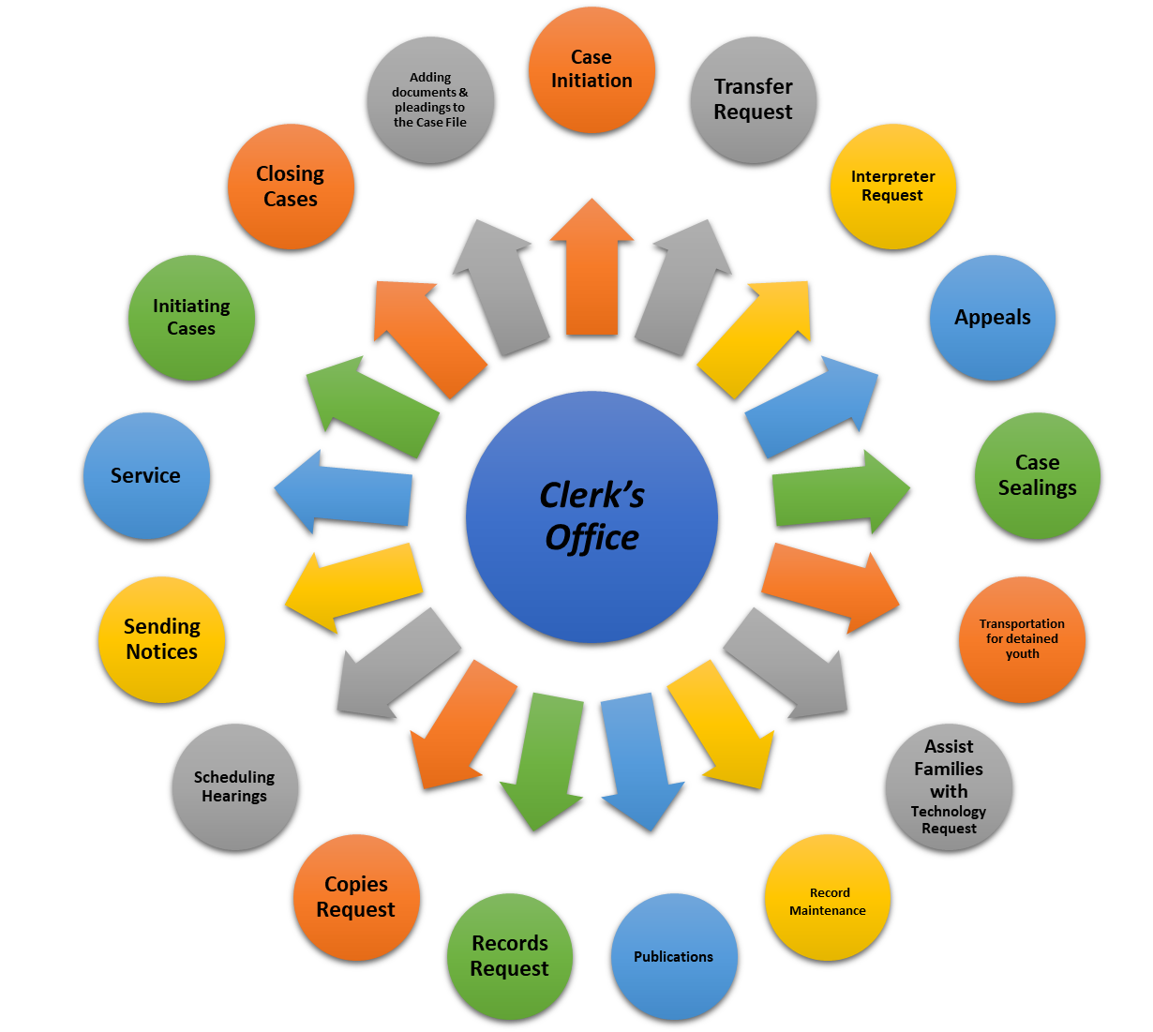
Responsibilities

Slide 16
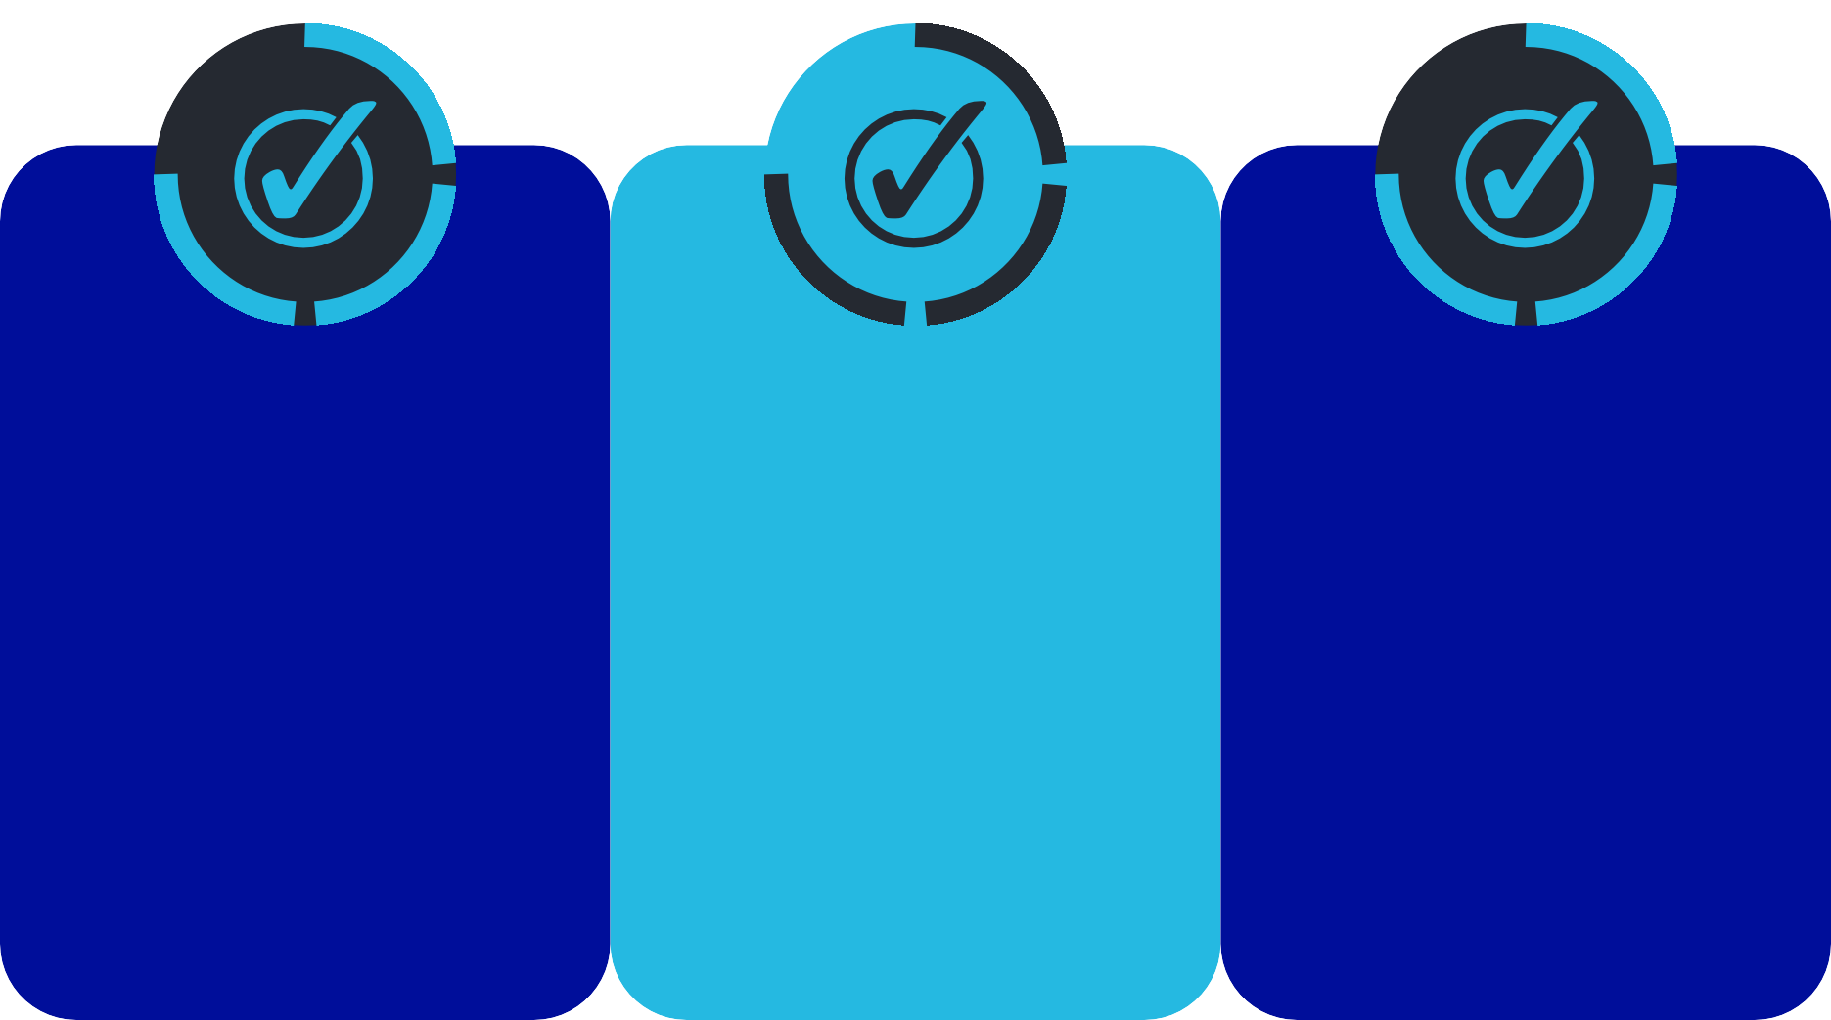
Programming & Grants
Programs at FCJC are provided for the treatment and rehabilitation of youth and support for their families.
Programs are offered through community resources that address:
Mentoring & Leadership
Mental Health
Community Service

Slide 17
To connect court and community-based programs and services to youth and families engaging community partners and service providers as well as the youth and their parents to strengthen families.
Right Program
Right Youth
Right Time

Slide 18
Accountability Courts
Provide a highly structured, coordinated, and holistic team-based approach for Accountability Court participants while simultaneously holding them accountable for their behavior.
ASCEND
CHOICES
HOPE
Alternative Solutions Creating Excellence Not Detention
Choosing Healthy Options Increases Confidence, Excellence, and Success
Helping Our Parents Excel

Slide 19
Benefits
Provides alternative sentencing to those with mental illnesses and/or substance use disorders
Works to lower recidivism by breaking the cycle of addiction and mental illness, which are the root causes of many offenses.
Recidivism rates for participants are lower compared to similarly situated offenders who do not participate

Slide 20
CHINS – Children in Need of Services
Goal: To reduce formal court involvement while connecting youth and their families to community-based and early intervention services that address their individual needs that will prevent delinquency.
Purpose: To ensure that referred youth receive early intervention services that address their individual needs that will prevent delinquency.
Target population:
Runaways
Truants
Unruly Youth

Slide 21
Court & Family Services
The mission of the Court and Family Services Division is to promote and provide for the safety, well-being, and permanence of children and their families. There are four sub-units: Citizen’s Review Panel, Education Advocacy, Mediation, and Guardian ad Litem. Combined, the division provides and manages services to qualifying children and families in support of the court’s mission.

Slide 22
EDUCATIONAL ADVOCATES
Educational Advocates are professionals who are usually called in when the child is not receiving services that are needed, not making educational progress with the services they have, or an IEP is not being followed.

Slide 23
Case Assignment Categories
Other:
Private Schools Charter Schools Virtual School
Settings
Altanta Public Schools ( APS)
Fulton County Public Schools ( FCPS)

Slide 24
CITIZEN’S REVIEW PANEL
Citizen’s Review Panel is a program consisting of trained volunteers from the community and is designed to assist the court in determining what the most appropriate permanency plan is for children in foster care.

Slide 25
Mediation Case Types
Dependency
Including Termination of Guardianship
Criminal Trespass Affray or Fighting Reckless Conduct
Simple Assault and Simple Battery; Battery Theft by Receiving ( less than 500 )
Theft by Services ( less than $ 500 ) and Theft by Taking ( less than $ 500 )
Delinquency
Gang Related Offenses;
Family/ Domestic Violence Sexual Offenses
Weapons and Drug Related Offenses
Exceptions

Slide 26
GUARDIAN AD LITEM (GAL)
Title 15 of the Official Code of Georgia requires that the court appoint a GAL for ALL dependent children and in certain circumstances for delinquents and Children in Need of Services (CHINS). GALs advocate for a child’s best interest and provide written reports with recommendations to the court and all parties involved.

Slide 27
WHEN IS A GAL NEEDED?
Parent is not present.
Parent and child’s interests are adverse.
Family Violence.
Parents want the child locked up though facts do not appear to warrant it.
Violation of Probation (VOP).
State of Georgia intends to call the parent as a witness against the child.
When a competency evaluation is requested.

Slide 28
Services
Provide clinical services, support, and psychoeducation to our youth, families, court staff members, and community stakeholders via training, presentations, and by highlighting Children’s Mental Health during Mental Health Awareness Month (May).
Goal
is to destigmatize mental illness and empower families to seek and receive effective behavioral health services essential to their child’s success at home, school, and in the community.
Impact
BHS is dedicated to the prevention, early intervention, and treatment of behavioral health-related issues and concerns impacting our youth and families.

Slide 29
Assessments
Diagnostic
Trauma
Substance Use Disorder
Psychiatric/Medication
Psycho-Sexual

Slide 30
Probation
Probation is a legal status in which an adjudicated juvenile is ordered by the court to comply with laws, rules, or specific terms while remaining in the least restrictive community setting for a conditional period.

Slide 31
Probation not only provides treatment, rehabilitation, and supervision but also strives to maximize public safety by holding youth accountable for their behavior using the most current and progressive means possible.

Slide 32
Probation Services
While on probation a juvenile is assigned a Probation Officer to supervise compliance with the court-ordered terms and advocate for services to address the need for rehabilitation. This is considered a balanced approach to rehabilitation.

Slide 33
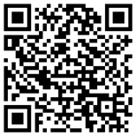
Cicely Barber
Chief Administrative Office
Fulton County Juvenile Court
cicely.barber@fultoncountyga.gov
Follow us:

