Slide 1
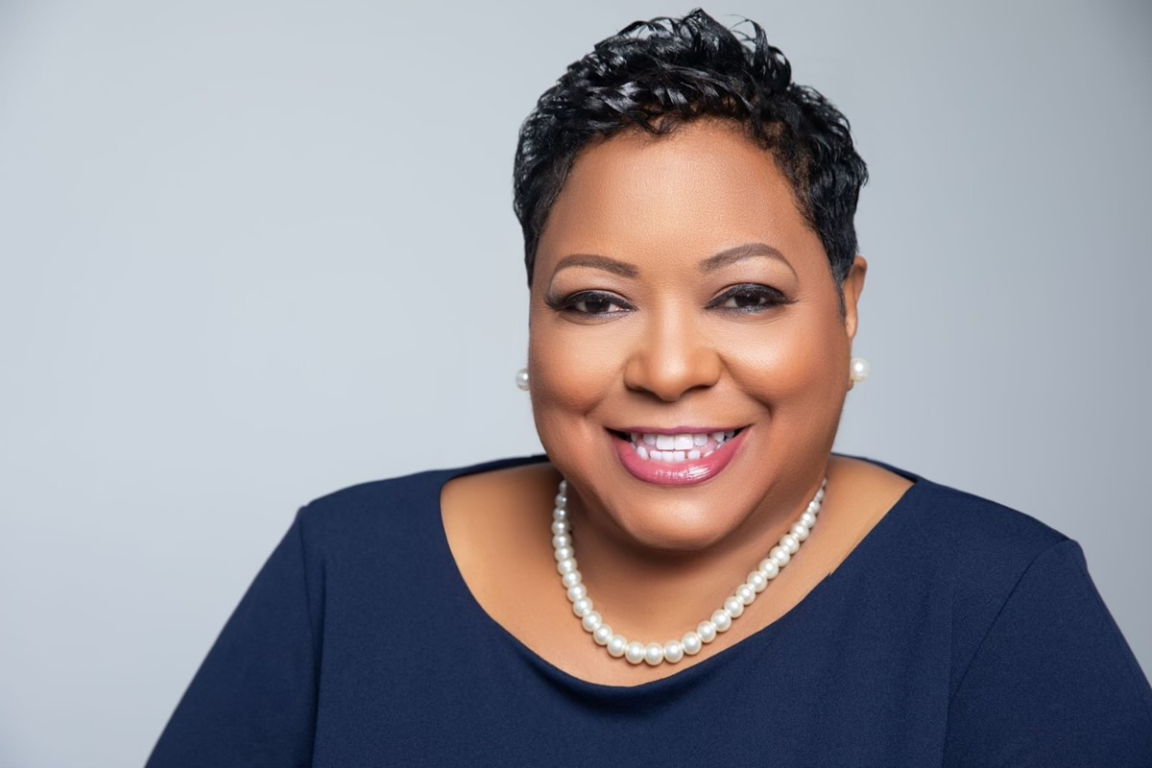
CHANGE OUT THIS PICTURE OUT WITH YOUR OWN. TO DO SO CLICK ON THE IMAGE HIT DELETE. THERE WILL BE AN ICON IN THE MIDDLE OF THE PICTURE, CLICK ON IT, THEN FIND YOUR PICTURE AND INSERT.
Welcome to the Clerk’s Office:
“People. Purpose. Passion.”
Honorable
Ché Alexander
Fulton County Clerk of Superior and Magistrate Courts

Slide 2
THE CLERK IS RESPONSIBLE FOR PROTECTING THE INTEGRITY OF PUBLIC RECORDS AND PUBLIC FUNDS
Our office receives and maintains criminal and civil court filings and serve as custodian of county land and property records.

Slide 3
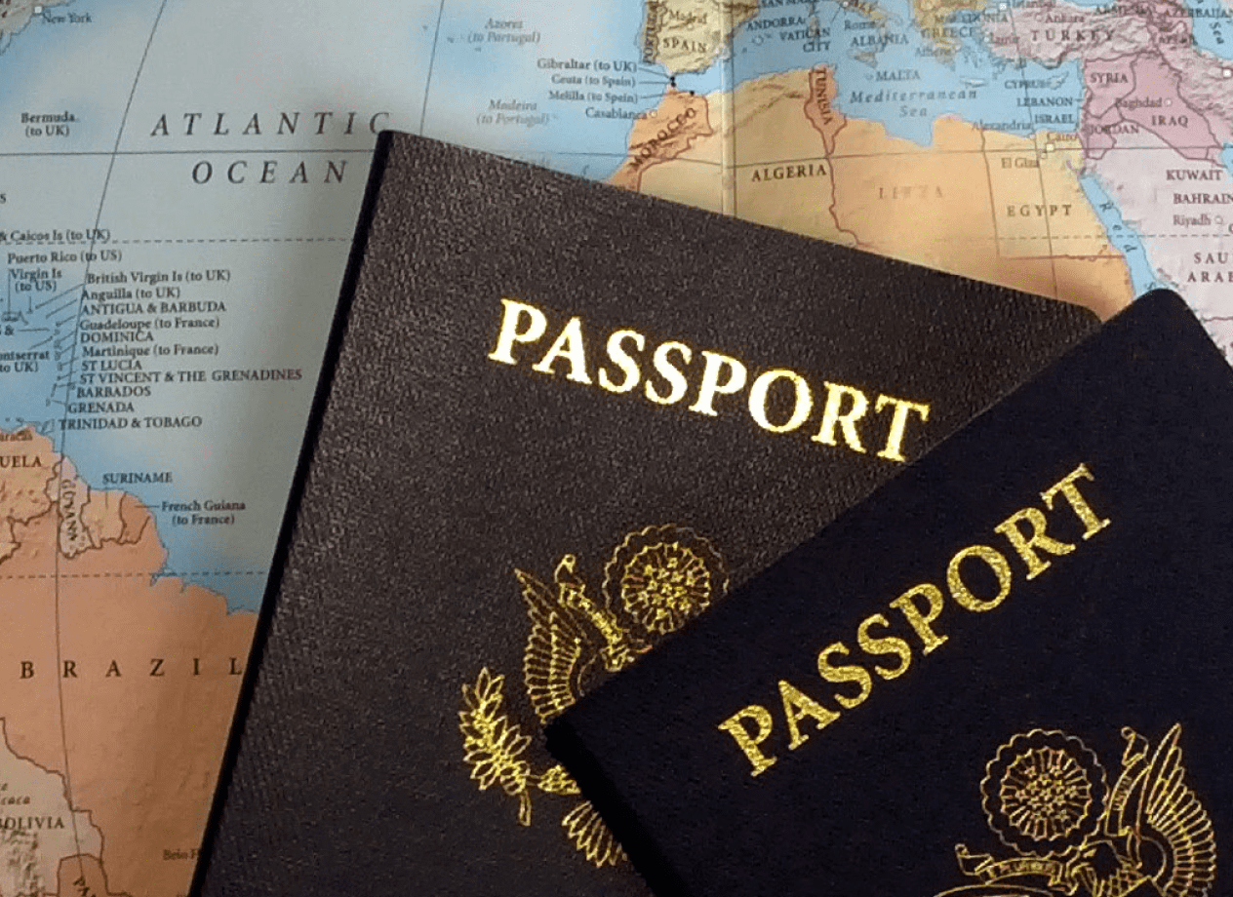
ADMINISTRATIVE
Account for all funds paid into the court registry
Reconcile and report funds collected in accordance with local and state statutes
Collect and manage all funds remitted to the courts
TREASURY
Process U.S. Passport Applications for transmittal to the U.S. State Department
Issue and approve applications for notary public commissions
PASSPORT/NOTARY
Administer Oaths
File and maintain Attorney Bar Admission records
OATHS

Slide 4
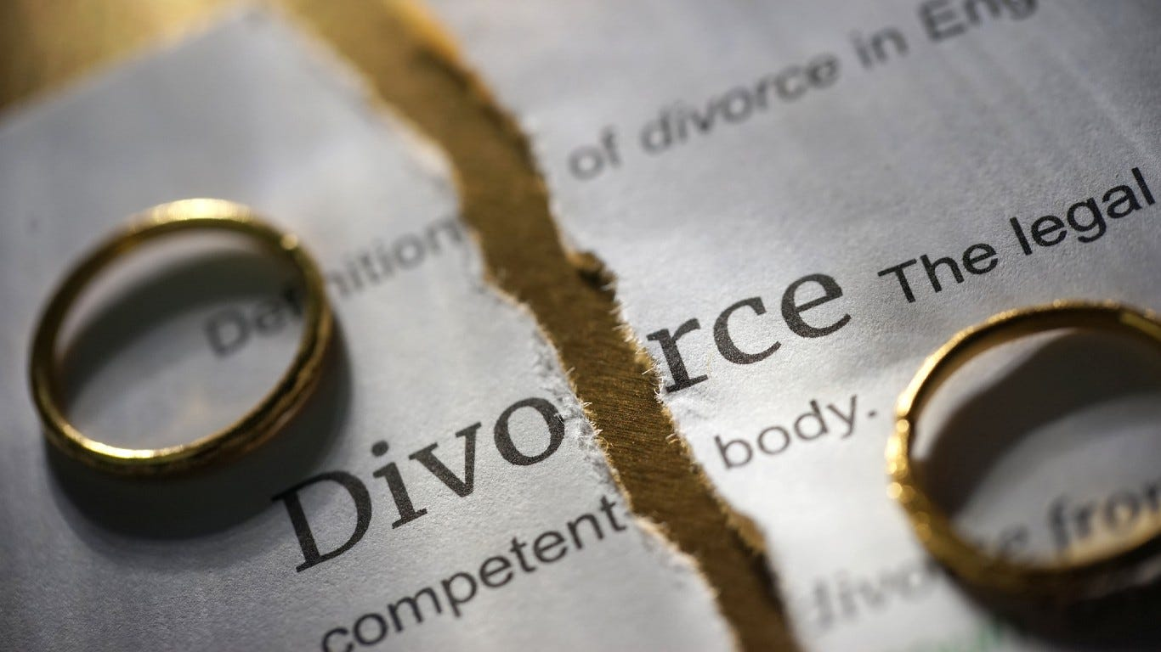
JUDICIAL FILING AND MAINTAINING:
Superior Court
Contract
General Tort
Divorce
Legitimation
Adoptions
Family Violence Protective Orders
Civil
Indictments
Appeals
Indictments
GCIC/Inmate Mail
Criminal

Slide 5
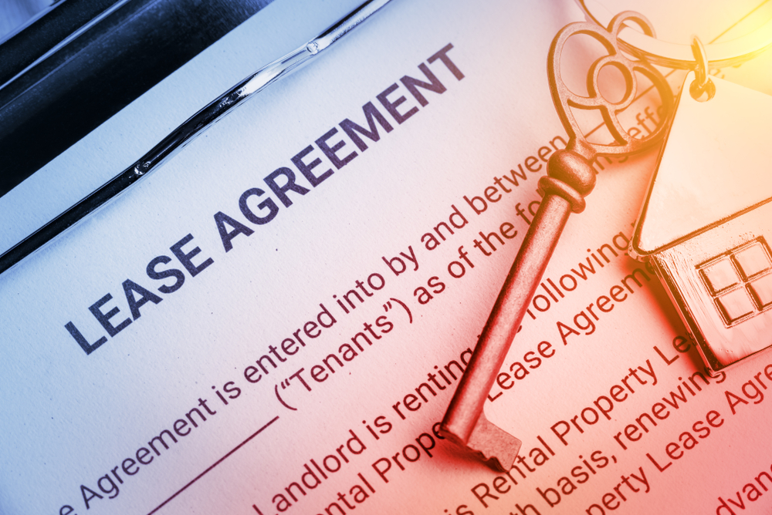
JUDICIAL FILING AND MAINTAINING:
Magistrate Court
Landlord-Tenant
Small Claims
Garnishments
Abandoned Motor Vehicles
Civil
First Appearance
Warrant Applications
Copy of Charges
Environmental
Criminal

Slide 6
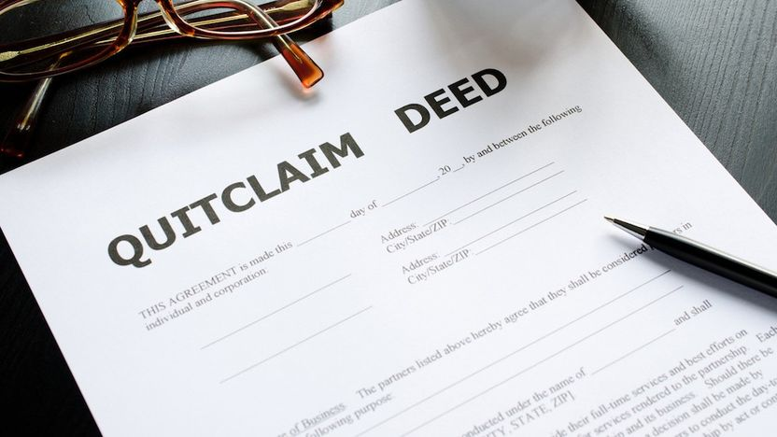
REAL AND PERSONAL PROPERTY
County Board of Equalization Appeal Administrator
BOE
Receive, index, maintain, and record deeds, plats, liens, and UCC Financing Statements
File and maintain Military Discharge records
Real Estate

Slide 7
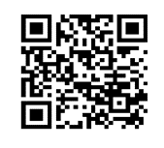
STAY CONNECTED WITH US!
Website: http://www.fultonclerk.org
Phone Number: 404-613-5313
Social Media:

