Slide 1


BOARD OF ASSESSORS

Slide 2
FULTON COUNTY BOARD OF ASSESSORS
CURRENT MEMBERS:
Edward London, Chair
Pamela Smith, Vice-Chair
Michael Fitzgerald
Melinda Kaplan
Lee Morris
Established in accordance with O.C.G.A. 48-5-290
5-member board appointed by the Fulton County Board of Commissioners
Discover and list all taxable real and personal property
Annual compilation of the tax digest
Approval of departmental policies and procedures
Appointment of a Chief Appraiser who oversees day-to-day operations

Slide 3
OPERATIONAL GUIDANCE
Official Code of Georgia Annotated (OCGA)
  Collection of all laws in the State of Georgia
  Index of state governing laws enacted by the Georgia Assembly which consist of two chambers
    House of Representatives
    Senate
      Title 48 – Revenue and Taxation
      Chapter 5 – Ad Valorem Taxation of Property

Slide 4
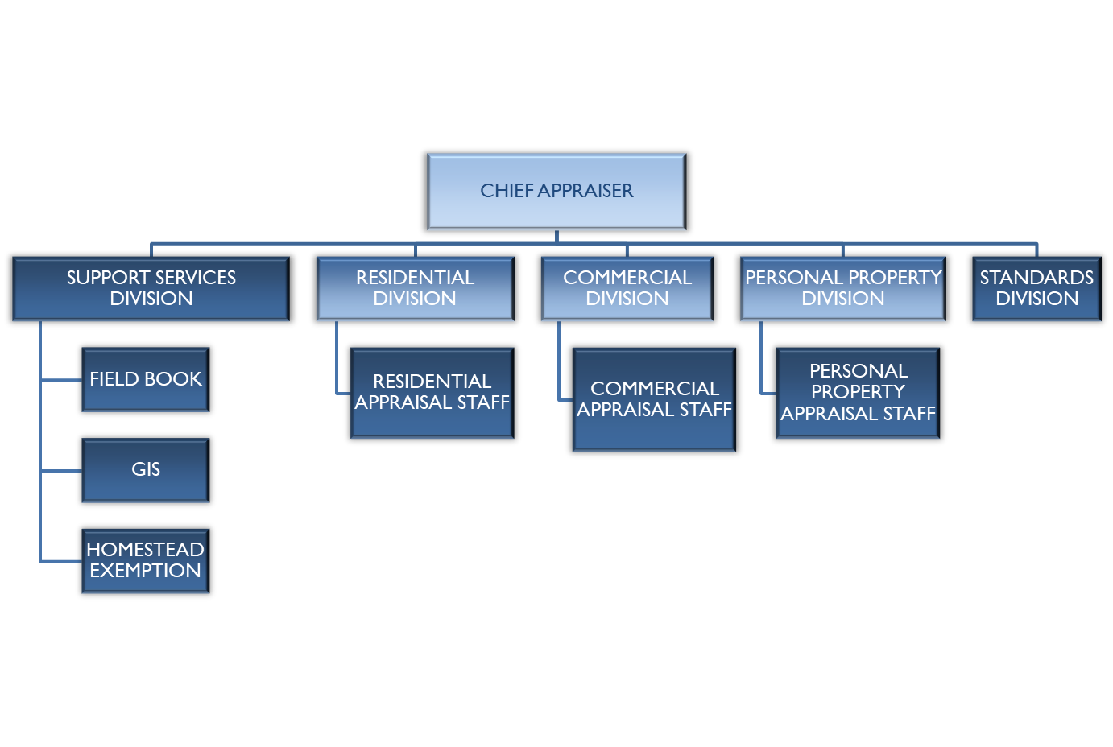
ORGANIZATIONAL CHART

Slide 5
DEPARTMENTAL OVERVIEW
365,000 Real Property Parcels
  92% Residential
  8% Commercial
28,000 Personal Property Accounts
200 Staff Members
  120 Appraisal
  80 Administrative

Slide 6




THE PROPERTY TAX PROCESS AT A GLANCE
Fulton County Assessors appraise your property at Fair Market Value, as required by Georgia law.
40%
  Assessed Value = 40% of Fair Market Value.
Homestead Exemptions are deducted from Assessed Value to calculate Taxable Value.
Fulton County, all cities and school systems set their annual millage (tax) rate.
Taxes are calculated and issued by the Tax Commissioner and some cities.

Slide 7
APPRAISAL TIMELINE
January 1 - Date of Assessment/Return Period Begins
April 1 - Return Period Expiration (Real & Personal Property)
April 1 – Homestead Exemption Deadline
(for current tax year)
July 1 (no later than) – Annual Notice of Assessment Mailing
September 1 (no later than) – Digest Submission

Slide 8
GEORGIA CODE
OCGA 48-5-40 Definitions - Homestead
  “Applicant” means a person who is:
    A married individual living with his or her spouse
    An individual who is unmarried but who permanently maintains a home for the benefit of one or more other individuals who are related to such individual or dependent wholly or partially upon such individual for support
    An individual who is widowed having one or more children and maintaining a home occupied by himself or herself and the child or children
    A divorced individual living in a bona fide state of separation and having legal custody of one or more children, when the divorced individual owns and maintains a home for the child or children
    An individual who is unmarried or is widowed and who permanently maintains a home owned and occupied by himself or herself

Slide 9
GEORGIA CODE
OCGA 48-5-40 Definitions - Homestead (continued)
  “Homestead” means the real property owned by and in possession of the applicant on January 1 of the taxable year and upon which the applicant resides including, but not limited to, the land immediately surrounding the residence to which the applicant has a right of possession under a bona fide claim of ownership. The term “homestead” includes the following qualifications:
  “Occupied primarily as a dwelling” means:
    The applicant or members of his family occupy the property as a home.
    No more than one exemption may be claimed pursuant to this subparagraph in connection with the occupancy of one building, except in the case of a duplex or double occupancy dwelling when the line of division follows a natural and bona fide plan as to both land and building and the two units thus formed are separately owned and occupied.

Slide 10

HOMESTEAD EXEMPTIONS
If you own and occupy a home in Fulton County, you may qualify for a homestead exemption.
A homestead exemption is a legal provision established by state law and local legislation that may reduce the assessed value of owner-occupied homes.
While you can apply for a homestead exemption at any time, the deadline in order to qualify for the current tax year is April 1st.

Slide 11

AVAILABLE EXEMPTIONS
There are a variety of exemptions available to the citizens of Fulton County.
  There are basic exemptions which only require the applicant to own and occupy the property as of January 1st to qualify.
  There are special exemptions for which one may qualify depending on their age and income levels.

Slide 12
APPLY FOR HOMESTEAD EXEMPTIONS
ONLINE FILING:
File through our online portal at www.fultonassessor.org
Upload documents at your convenience
Electronic record of your filing
MANUAL FILING:
Administrative Office
Satellite Locations

Slide 13
REQUIRED DOCUMENTATION
A BASIC HOMESTEAD EXEMPTION:
A valid Georgia Driver’s License or Georgia Identification Card
Registration for vehicles owned by and registered by the property owner(s)
Social Security Number
SPECIAL EXEMPTIONS (SENIORS AND INCOME BASED):
State and Federal Tax Returns
Social Security Award Letter (if you do not file income tax)
PROPERTY IN THE NAME OF A TRUST:
Trust affidavit
Your name must be on the deed in order to apply.

Slide 14
GEORGIA CODE
OCGA 48-5-2 Definitions
  “Arm’s length, bona fide sale” means a transaction which has occurred in good faith without fraud or deceit carried out by unrelated or unaffiliated parties, as by a willing buyer and a willing seller, each acting in his or her own self-interest, including but not limited to a distress sale, short sale, bank sale, or sale at public auction.
  “Fair market value of property” means the amount a knowledgeable buyer would pay for the property and a willing seller would accept for the property at an arm’s length, bona fide sale.

Slide 15
GEORGIA CODE
OCGA 48-5-269.1 Adoption by commissioner and requirement of use of uniform procedural manual for appraising tangible personal property.
directed the Revenue Commissioner to provide local tax assessing officials with uniform procedures to be used in the appraisal of all real and personal property
  The commissioner shall adopt by rule, subject to Chapter 13 of Title 50, the “Georgia Administrative Procedure Act,” and maintain an appropriate procedural manual for use by county property appraisal staff in appraising tangible real and personal property for ad valorem tax purposes.

Slide 16
GEORGIA CODE
OCGA 48-5-269.1 (continued)
  The manual adopted by the commissioner pursuant to this Code section shall be utilized by county property appraisal staff in the appraisal of tangible real and personal property for ad valorem tax purposes.
Supplemental Rules and Regulations of the State of Georgia
  Appraisal Procedures Manual (APM) - 560-11-10

Slide 17
APPRAISAL PROCESS
Processing of Land Splits & Combinations
Listing of New Construction
Processing of Permitted Activity
Sales Verification
Revaluation of Assessments (based on the market)
Processing of Appeals

Slide 18

PROPERTY ASSESSMENT BASICS
How do you establish the value of my house?
Location
Review of Property Characteristics
  Size of Lot
  Improvement Square Footage
  Age
  Quality of Construction
  Condition
  Bathroom Count
Renovations/Remodels
Sales of comparable properties

Slide 19
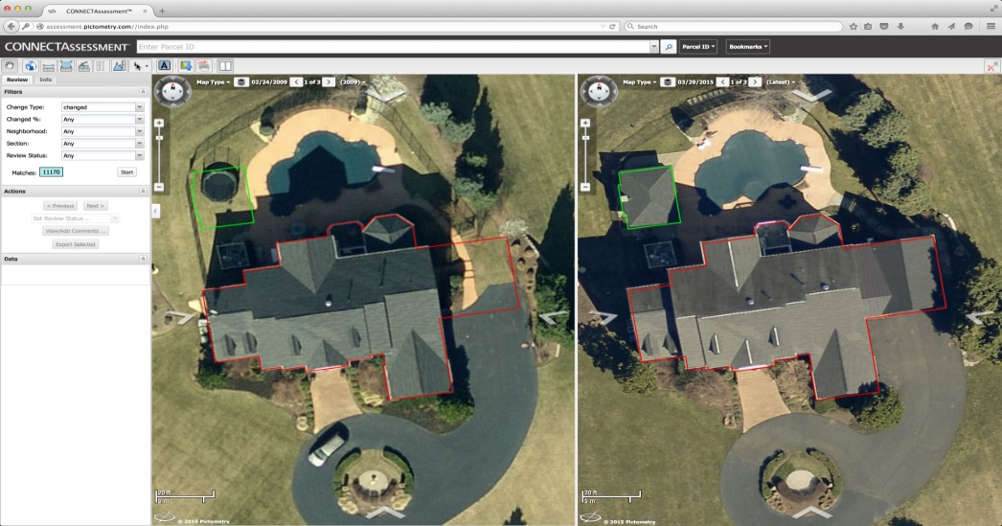
WHAT DATA IS REVIEWED IN ASSESSING PROPERTY?
In addition to assessors reviewing properties in the community, the Tax Assessors’ Office uses many sources of information to set property values, including:
Sales Data
Aerial Photos
Building Permits
Input from Property Owners

Slide 20
GEORGIA CODE
OCGA 48-5-306 Annual notice of current assessment; contents; posting notice; new assessment description.
  Method of giving annual notice of current assessment to taxpayer
  The board shall give annual notice to the taxpayer of the current assessment of taxable real property. When any corrections or changes, including valuation increases or decreases, or equalizations have been made by the board to personal property tax returns, the board shall give written notice to the taxpayer of any such changes made in such taxpayer’s returns. The annual notice may be given personally by leaving the notice at the taxpayer’s dwelling house, usual place of abode, or place of business with some person of suitable age and discretion residing or employed in the house, abode, or business, or by sending the notice through the United States mail as first-class mail to the taxpayer’s last known address.

Slide 21
GEORGIA CODE
OCGA 48-5-306 (Continued)
Contents of notice
  The annual notice of current assessment required to be given by the county board of tax assessors under subsection (a) of this Code section shall be dated and shall contain the name and last known address of the taxpayer. The annual notice shall conform with the state-wide uniform assessment notice which shall be established by the commissioner by rule and regulation and shall contain:
    The amount of the previous assessment
    The amount of the current assessment
    The year for which the new assessment is applicable
    A brief description of the assessed property broken down into real and personal property classifications

Slide 22
GEORGIA CODE
OCGA 48-5-306 (Continued)
Contents of notice
    The fair market value of property of the taxpayer subject to taxation and the assessed value of the taxpayer’s property subject to taxation after being reduced
    The name, phone number, and contact information of the person in the assessors’ office who is administratively responsible for the handling of the appeal and who the taxpayer may contact if the taxpayer has questions about the reasons for the assessment change or the appeals process
    If available, the website address of the office of the county board of tax assessors

Slide 23
GEORGIA CODE
OCGA 48-5-306 (Continued)
Contents of notice
  The notice shall also contain the following statements in bold print:
    “The estimate of your ad valorem tax bill for the current year is based on the previous or most applicable year’s millage rate and the fair market value contained in this notice. The actual tax bill you receive may be more or less than this estimate. This estimate may not include all eligible exemptions.”
  The annual notice required under this Code section shall be mailed no later than July 1.

Slide 24
ANNUAL NOTICES OFSSESSMENT

Slide 25
GEORGIA CODE
OCGA 48-5-311 Creation of county boards of equalization; duties; review of assessments; appeals.
Appeal
  Any taxpayer or property owner as of the last date for filing an appeal may elect to file an appeal from an assessment by the county board of tax assessors to:
    The county board of equalization as to matters of taxability, uniformity of assessment, and value, and, for residents, as to denials of homestead exemptions
    A hearing officer as to matters of value and uniformity of assessment for a parcel of non-homestead real property and personal property with a fair market value in excess of $500,000.00
    An arbitrator as to matters of value

Slide 26



APPEALING YOUR PROPERTY ASSESSMENT
If you do not believe your assessment represents
fair market value for your property,
you may file an appeal with the Board of Assessors.
Property owners may appeal their appraised value on the basis of…
VALUE
UNIFORMITY
TAXABILITY
EXEMPTION DENIED
BREACH OR DENIAL OF COVENANT
Assessed value of the property
Comparison to similar properties in neighborhood
Whether property is taxable
Qualified exemption not applied
Applies to covenants for agricultural properties
APPEALS MAY BE FILED:
ONLINE
IN PERSON
BY MAIL

Slide 27
APPEALING YOUR ASSESSMENT
When you file an appeal, you may choose:
Board of Equalization
Hearing Officer
(for non-homestead property with fair market value above $500,000)
Arbitration
(fees may apply)
After your hearing with the Board of Equalization, you will receive a written notice of the decision.
You have 30 days to appeal the decision to Superior Court.

Slide 28
ONLINE SERVICES
Homestead & Special Exemptions
Real Property Returns (Jan. 1 – April 1)
Business Personal Property, Aircraft
& Marine Returns (Jan 1 – April 1)
Real and Business Personal Property Appeals
Change of Mailing Address (Real Property Only)

Slide 29
WEBSITE ENHANCEMENTS
Easy to Navigate
Improved User Experience
Comparable Search Module
  Allows selection of various property characteristics to compare similar types of properties
  Generates a report that includes a data summary of each property and a map displaying the parcels

Slide 30
CONTACT US
MAIN LOCATION:
Peachtree Center @ 235 Peachtree St. (Administrative Office)
Phone: 404-612-6440
SATELLITE LOCATIONS:
Government Center @ 141 Pryor St.
Alpharetta @ 11575 Maxwell Rd.
Greenbriar Mall @ 2841 Greenbriar Parkway
North Fulton Service Center @ 7741 Roswell Rd. NE
South Fulton Service Center @ 5600 Stonewall Tell Rd.

Slide 31

QUESTIONS

