Slide 1

DEPARTMENT OF BEHAVIORAL HEALTH & DEVELOPMENTAL DISABILITIES
Notes:
LaTrina

Slide 2

Fulton County Behavioral Health & Developmental Disabilities
We are dedicated to improving the quality of life of Fulton County residents living with mental health and/or substance use disorders by offering an array of service options to meet the identified need. To reduce the stigma of mental illness and addiction, we are focused on increasing community awareness.
MISSION
The Fulton County Department of Behavioral Health & Developmental Disabilities (BHDD), as a community leader, facilitates the coordination of services through the FC Behavioral Health Network which expands accessibility to barrier-free person-centered behavioral health services to all residents of Fulton County regardless of their ability to pay.
Notes:
Erika

Slide 3


Fulton County Behavioral Health & Developmental Disabilities
We are dedicated to County residents living with mental health and/or substance use disorders by offering an array of service options to meet the identified need. To reduce the stigma of mental illness and addiction, we are focused on increasing community awareness.
the quality of life of Fulton County residents living with mental health and/or substance use disorders by offering an array of service options to meet the identified need. To reduce the stigma of mental illness and addiction, we are focused on increasing community awareness.
VISION
Our vision is to be a dependable resource for all residents living with a mental health and/or substance use disorder to become empowered to achieve independence & self-advocacy on their journey to wellness.
Notes:
Afrika

Slide 4

DATA
Nationally
55% of Adults with a mental illness have not received any treatment
State of Georgia
33.9% of adults in GA reported symptoms of anxiety and/or
Depressive disorder
Fulton County
14.1 % of adults report frequent mental distress, compared to the State's 16.1%
The Most Common mental health disorder in America is Anxiety
Notes:
Lynnette

Slide 5

2023 Budget: Department of BHDD
The 2023 budget for the Fulton County Department of Behavioral Health & Developmental Disabilities (BHDD) is funded by Fulton County Government’s General Fund.
Currently BHDD’s budget is $18.4 Million
Notes:
Lynnette

Slide 6
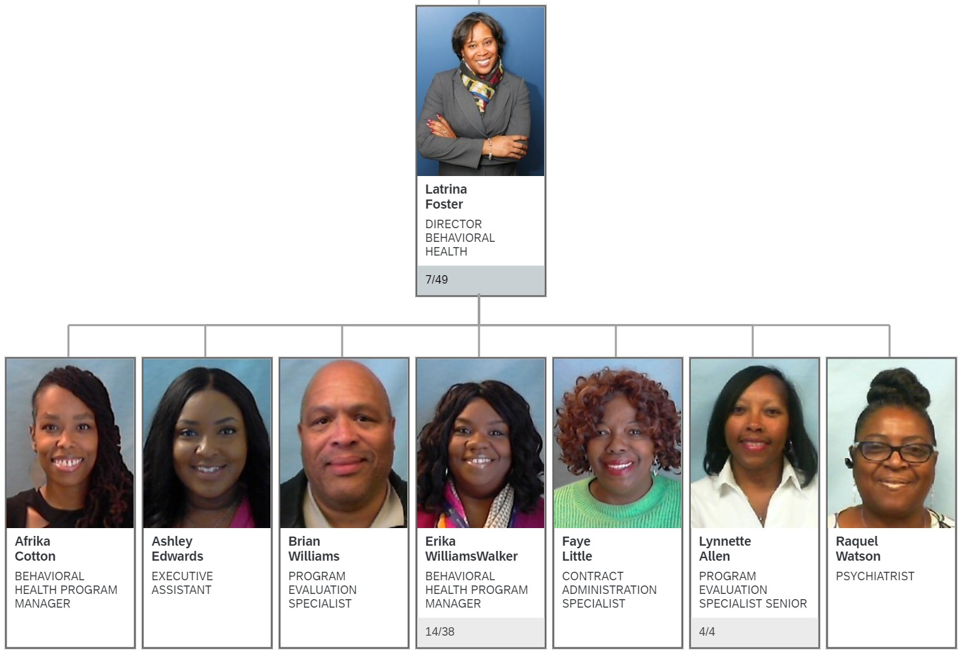
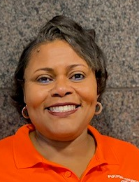
Fulton DBHDD Organizational Chart
Darlene
Whitlow
Notes:
Afrika

Slide 7

ADULT BEHAVIORAL HEALTH
Notes:
Erika

Slide 8
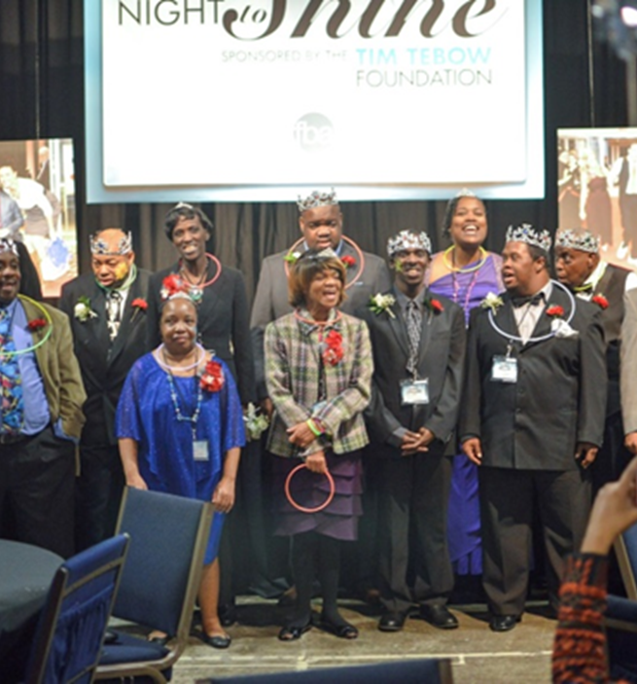
DEVELOPMENTAL DISABILITIES
The Department provides outpatient day services programming for adults with intellectual developmental disabilities. These services include:
Diagnostic Assessment
Individualized Service Plans
Community Integration
Nursing Assessments
Individual and Group Training
Prevocational Services
Psycho-educational Training
Parent/Caregiver Support Group
Supported Employment Referrals
Notes:
Erika

Slide 9
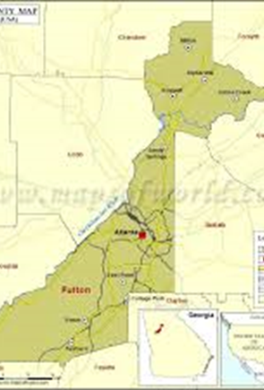
DEVELOPMENTAL DISABILITIES LOCATIONS
Central & South Training Center
  425 Langhorn Street, SW Atlanta, GA 30310
  (404)-612-8400
  (serving both Central and South staff and individuals)
North Training Center
  5025 Roswell Road, NE Sandy Springs, GA 30342
  (404)-303-6166
Notes:
Erika

Slide 10

Notes:
Erika

Slide 11
Fulton
County Behavioral Health Network
At the beginning of 2023, Fulton County Department of Behavioral Health & Developmental Disabilities (BHDD) formed the new Behavioral Health Network, a "next-level" continuum of care that provides behavioral health services to Fulton County residents.
Through the Behavioral Health Network, the Department of BHDD ensures that under-served communities have expanded access to high-quality comprehensive services that incorporates national standards of "Best Practices".
BHDD strives to ensure access to quality behavioral health services for children, adolescents, & adults, regardless of income or insurance. This model has allowed Fulton County to initiate a provider network, increase the number of clients served, expand the number of behavioral health programs offered, and reduce cost.
Contracted Providers include Georgia Hope/Health Connect America, Grady Behavioral Health, Chris 180, River Edge Behavioral Health, Women on the Rise, Summit Counseling Center and Step Up on Second
Currently, the Fulton County Department of BHDD serves as one of a handful of outpatient mental health and substance use disorder providers in the County.
Notes:
Erika

Slide 12

ADULT BEHAVIORAL HEALTH LOCATIONS
The Center for Health & Rehabilitation. 265 Boulevard NE, Atlanta 30312 – River Edge
North Fulton Service Center. 7741 Roswell Rd, Sandy Springs 30350 - Grady
South Fulton Service Center. 5600 Stonewall Tell, College Park 30349 - Grady
Notes:
Erika

Slide 13

CORE SERVICES
The Department provides core outpatient behavioral health services for adults experiencing mental health and/or substance use disorders. Core outpatient behavioral health services include:
Psychiatric Evaluations
Behavioral Health Assessments
Case Management & Skills Building
Nursing Evaluations
Individual, Family and Group Counseling
Peer Support Services
Diagnostic Assessments
Addiction Services
Crisis Intervention
Medication Management
It is the Department’s goal to offer no to low cost, barrier-free access to services to Fulton County residents. The priority of the Department is to ensure that individuals who are uninsured or underinsured have access to care.
Notes:
Erika

Slide 14
Scenario for Adult
Behavioral Health
John is 45 y.o. male who recently has been hearing voices and it is affecting his everyday functioning. He lives in South Fulton, doesn’t have any medical insurance and has no idea of how he can get help. What would you tell John to do?
Notes:
Tiarra

Slide 15

SPECIALTY SERVICES – JUDICIAL
Misdemeanor Mental Health Court
River Edge (cannot refer to program)
Fulton County DBHDD, in collaboration with Magistrate & State Courts, established the Misdemeanor Mental Health Court Program (MMC) on July 5, 2018.
The MMC is a voluntary 12-month program to divert eligible misdemeanor citizen-defendants with serious mental illness and co-occurring disorders from traditional sentencing to a supportive treatment program.
The MMC Treatment Team assists in creating and reinforcing treatment goals, with assistance from the courts, monitors and provides linkages to community resources. Those resources include assistance with housing, medical services, education, employment, mental health services and other community-based service needs.
Notes:
Afrika

Slide 16
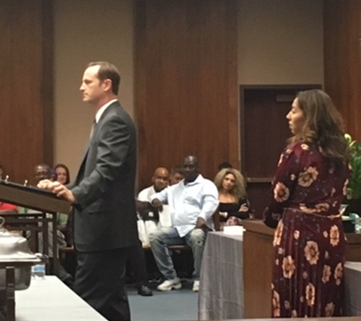
SPECIALTY SERVICES – JUDICIAL
Recovery (DUI) Treatment Court – River Edge (cannot refer to program)
The mission of the Fulton County Recovery Treatment Court is to enhance public safety and promote healthier lifestyles for repeat DUI offenders. The Court combines increased supervision and accountability with effective and intensive treatment.
There are six (6) required components to participate in the DUI Treatment Court:
Cognitive Behavioral Therapy
Completion of DDS DUI, Alcohol or Drug Risk Reduction Program
Submission to random home visits
Random drug testing
Participation at compliance reviews
Community support meetings such as AA/NA
BHDD, in collaboration with State Court, provides treatment support for the Fulton County DUI Court Program. The Recovery Treatment Court Program is a post-conviction treatment program for those who have multiple violations of driving while under the influence of alcohol or other intoxicants. The DUI Court Program is a vital component of the probation portion of a DUI sentence.
Notes:
Afrika

Slide 17
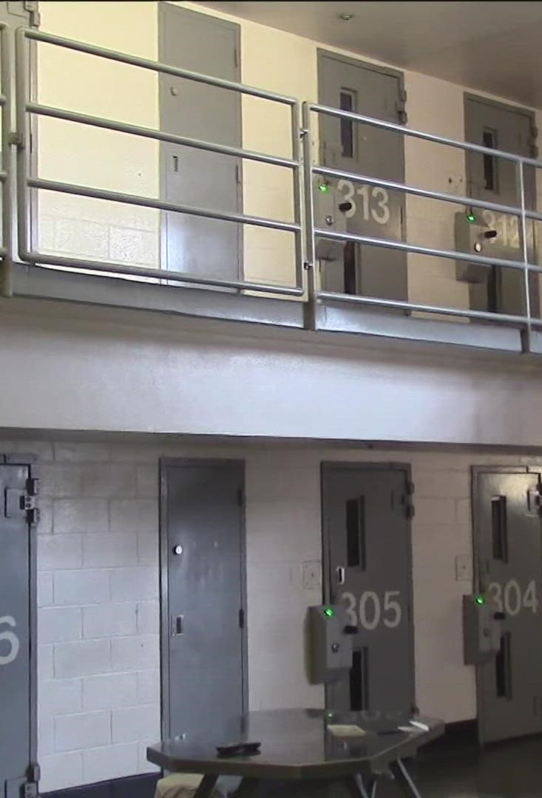
SPECIALTY SERVICES – JUDICIAL
Screening and Re-Entry Unit
Grady (cannot refer to program)
The Fulton County Department of BHDD implemented a Screening and Re-Entry Unit (SRU) as recommended by the Justice & Mental Health Task Force on September 25 2019. The goal of the SRU is to serve as an early detection to identify mental health concerns with inmates in the Fulton County jails by administering the Correctional Mental Health Screening (CMHS) to 100% of eligible bookings.
The Fulton County Information Technology and Strategy Departments created a secured database which scores and stores the screening information.
Notes:
Afrika

Slide 18
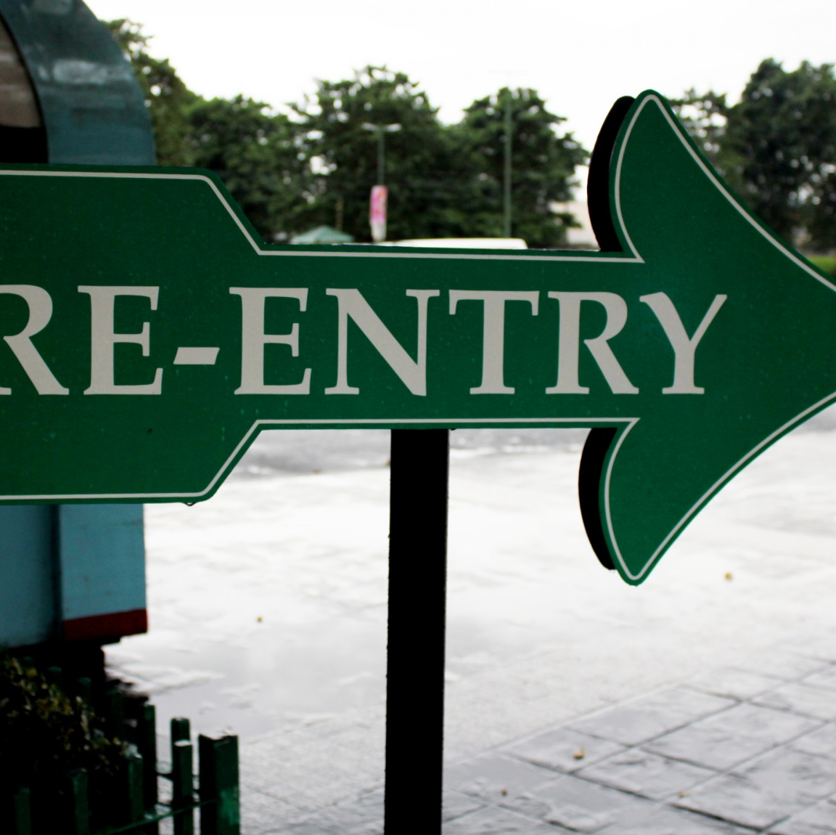
SPECIALTY SERVICES –JUDICIAL
Re-Entry Team
Women on the Rise (limited referral)
For those inmates recognized to have mental health concerns on the CMHS (scoring 5 or more), the GAINS (Gather, Access, Integrate, Network and Stimulate) checklist is administered by the assigned discharge planner to assess for social service needs that will aid in a successful transition into the community. This provides the opportunity for discharge planning to begin at booking.
RE-ENTRY TEAM
The Department of Behavioral Health has implemented a Re-Entry team with a focus on women at Union City. The Re-Entry program is a completely voluntary community-based program that offers case management support services for individuals that are incarcerated within Fulton County jails. Individuals with behavioral health needs, including substance use disorders, mental illness, trauma histories, and extensive involvement in the criminal justice system are in the priority focus group for the program. Participants in the Re-Entry program receive a continuum of care for up to one year after release to support positive choices, constructive behavior and accountability, thereby minimizing chances to reoffend.
Notes:
Afrika

Slide 19
Scenario for Judicial System
A Fulton County resident has been arrested for a minor altercation. The client is in Fulton County jail. The client has a reported history of mental health concerns but does not carry a diagnosis. The client is concerned and wondering what resources are available to assist them with this situation.
What do you suggest?
Notes:
Tiarra

Slide 20
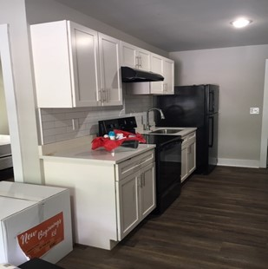
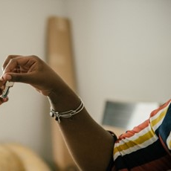
HOUSING SUPPORT SERVICES
River Edge & Step Up (cannot refer to program)
Fulton County Department of Behavioral Health and Developmental Disabilities has partnered with Partners for HOME, the Atlanta Housing Authority and Georgia DBHDD to provide housing support services to individuals and families that have transitioned from homelessness to long-term housing solution.
The Supportive Housing team assists in providing service linkages in the following areas:
Housing maintenance and stability: (paying bills, interacting positively with landlords and neighbors)
Health maintenance (medical, dental, vision)
Connection to mental health, recovery and addiction counseling, and other supportive counseling services
Financial literacy
Managing behaviors associated with mental illness or substance use
Developing crisis plans, Entitlement assistance (SSI, SSDI, Medicaid, Medicare, SNAP, etc)
Daily living skills
Job re-entry and supportive employment
Education
Transportation
Tenancy compliance
Notes:
Afrika

Slide 21
Permanent Supportive Housing Scenario
A Fulton County resident is in danger of losing their housing. They are employed but has been struggling to cover their bills since the pandemic. The resident is concerned about becoming homeless. What do you suggest?
Notes:
Tiarra

Slide 22

OPIOID USE DISORDER TREATMENT
Contractual agreement with Grady Health Systems Behavioral Health Clinic
Medication Assisted Outpatient Treatment is available for Fulton County residents with opioid use disorders
Services include individual and group therapy with licensed clinicians and peer counselors
Medications include buprenorphine/naloxone or suboxone
Connections to local 12-step support groups to assist in sustaining long term recovery
Walk-ins or hospital referrals are welcome
Notes:
Lynnette

Slide 23

MINORITY HIV INITIATIVE
C.L.A.S.S PROGRAM
River Edge
The Community Linkage Adherence Support Services Program is available to serve Fulton County residents that are:
African American or Latino male or transgender persons
Between the ages of 18 – 59
HIV Positive or at higher risk for becoming positive
Have substance use and/or mental health disorders
Program provides linkage to housing referrals, social and health services and treatment for substance use and mental health disorders.
For more information, call 404-376-5366 or 404-372-2869
Notes:
Lynnette

Slide 24
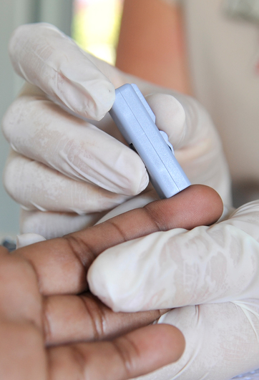
HIV PREVENTION EDUCATION
& SCREENING
Prevention Counseling and Education is offered to every individual enrolled in treatment for substance use and mental health disorders.
Services currently offered at The Center for Health & Rehabilitation and the South Fulton Service Center
Services are provided by a certified HIV Counselor and Health Educator at no cost to the clients.
The Insti Rapid tests are used and clients receive their results immediately unless further testing is needed.
Notes:
Lynnette

Slide 25

CHILD, ADOLESCENT & EMERGING ADULT BEHAVIORAL HEALTH
Notes:
Erika

Slide 26
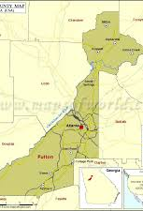
YOUTH PROGRAM LOCATIONS
Adamsville Regional Health Center, 3700 Martin Luther King Jr. Drive, SW Atlanta, GA 30331 – CHRIS 180
Fulton County Clubhouse for Youth, 1480 DeLowe Drive, SW, Atlanta, GA 30311 – CHRIS 180
North Fulton Service Center, 7741 Roswell Road, Sandy Springs, GA 30350 – CHRIS 180
Oak Hill Child, Adolescent & Family Center, 2805 Metropolitan Parkway, SW, Atlanta, GA 30315 – GA Hope
Notes:
Erika

Slide 27

CORE SERVICES
The Department provides core outpatient behavioral health services for children and adolescents experiencing mental health and/or substance use disorders. Core outpatient behavioral health services include:
Psychiatric Evaluations
Behavioral Health Assessments
Case Management & Skills Building
Nursing Evaluations
Individual, Family and Group Counseling
Diagnostic Assessments
Addiction Services
Crisis Intervention
Medication Management
It is the Department’s goal to offer no to low cost, barrier-free access to services to Fulton County residents. The priority of the Department is to ensure that individuals who are uninsured or underinsured have access to care.
Notes:
Erika

Slide 28
Scenario for Children &
Adolescents
You are the legal guardian for your 10 y.o. Niece and she has been struggling in school and at home. She does not engage with family and stays in her room most of the time, hasn’t made any friends at her new school, doesn’t want to play with her dolls anymore and just seems sad all the time. What would you do to help her?
Notes:
Tiarra

Slide 29
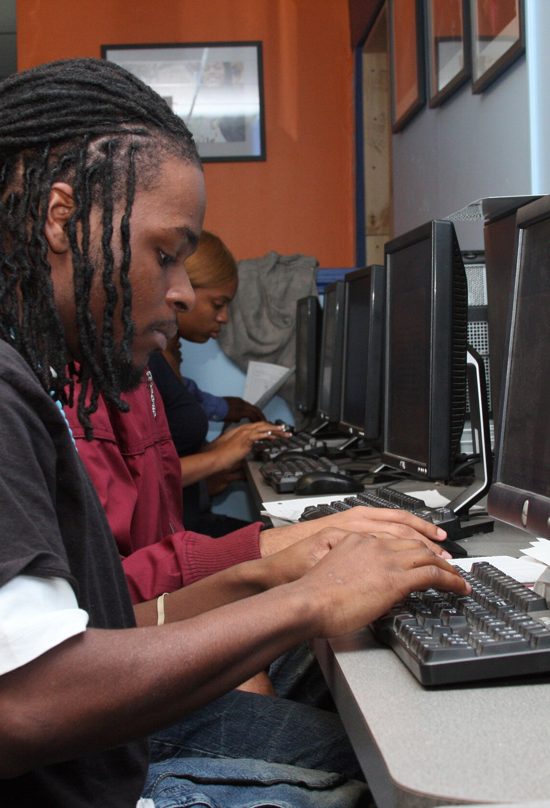
RE-ENTRY TEAMS – Emerging Adults (18-24)
CHRIS 180 (limited referral)
The Department implemented a Re-Entry team focused on the Emerging Adult population at Rice Street and Union City Jails. The Re-Entry program is a completely voluntary community-based program that offers case management support services for individuals incarcerated within Fulton County jails. Individuals with behavioral health needs, including substance use disorders, mental illness, trauma histories, and extensive involvement in the criminal justice system are in the priority focus group for the program. Participants in the Re-Entry program receive a continuum of care for up to one year after release to support positive choices, constructive behavior and accountability, thereby minimizing chances to reoffend.
As a result of the COVID-19 pandemic, the Department pulled this team from the field in order to protect the safety of the clients and staff by March 16, 2020. The team was instructed to maintain telephonic case management services with all active clients. The Department continues to work with the medical/mental health provider in the Fulton County Jail and the Public Defenders’ Office to monitor jail releases.
Notes:
Afrika

Slide 30
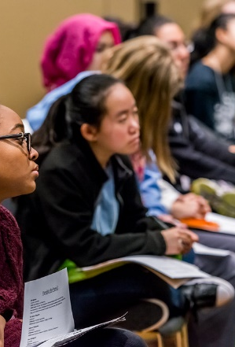
Clubhouse for Youth
CHRIS 180
The Recovery Support Clubhouse for Youth is a place where adolescents, ages 13 – 17, can spend their out of school time during nontraditional hours learning the tools, alternatives, coping skills, and socialization strategies to keep them safe and drug free. Youth participate in life skills groups, social outings, educational supports, career development/exploration, and other activities to maintain a healthy and sober lifestyle. The Clubhouse is funded through a federal grant managed by the State of Georgia. Transportation is provided.
Services are offered in a group setting and include:
Substance abuse prevention education
Behavioral health psycho-education
Life and daily living skills (cooking, budgeting, time management, health and wellness)
Activities include sporting events, video games, pool table and foosball
Homework assistance, and customized employment preparation
Youth/Peer/Family led group activities including monthly family dinners
Upon completion of the program, participants are encouraged to share their experiences with their peers through Positive Peer Mentoring
Notes:
Erika

Slide 31
Scenario for Clubhouse for Youth
A Probation Officer (PO) is looking for a program for one of his adolescent clients who are in need of substance abuse education and wants to introduce him to other more productive ways to spend their time. They are afraid without the proper intervention, the adolescent will end up dropping out of school or their probation being revoked. Which program would you tell the PO about?
Notes:
Tiarra

Slide 32

SCHOOL-BASED THERAPY
CHRIS 180 & Summit (limited referral)
School-based Mental Health Therapy is currently being provided in 66 schools within the Fulton County School District.
Behavioral Health provider CHRIS 180 and Summit Counseling, Inc. provides school-based therapy to students identified and referred by school counselors, teachers and staff.
Funding is provided to hire clinicians for staffing the school-based programs along with other programmatic needs.
Individual sessions are provided to students currently utilizing a hybrid model based upon the district’s policies. Virtual and in-person sessions are available.
Notes:
Lynnette

Slide 33

TEXT 4 HELP
CHRIS 180 (cannot refer to program)
Utilizing LEAD’s, (Linking Efforts Against Drugs), technology beginning in 2018, the Text 4 Help Program enables all public middle and high school students within Fulton County access to the confidential texting line free of cost.
Text 4 Help allows students to connect confidentially through text messages to licensed mental health professionals for resources and referrals 24 hours a day/ 7 days per week. As a part of CHRIS 180’s contract with BHDD, licensed clinicians are on call 24/7 to receive & respond to text messages usually within 3 minutes of receipt of a text.
Notes:
Lynnette

Slide 34
Scenario for School Based Services
Your 15 y.o. child is constantly disrupting his class and displaying anger issues and his Teacher reaches out to you to express her concerns and wants to refer him/her for therapeutic services. You haven’t had good experiences with the mental health system in the past. What would you do?
Notes:
Tiarra

Slide 35
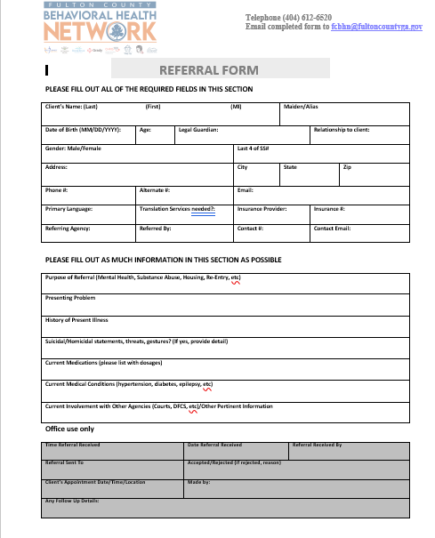
Making a referral is EASY
BHDD Main Office 404-612-6520
Referral Email: fcbhn@fultoncountyga.gov
Notes:
Erika

Slide 36
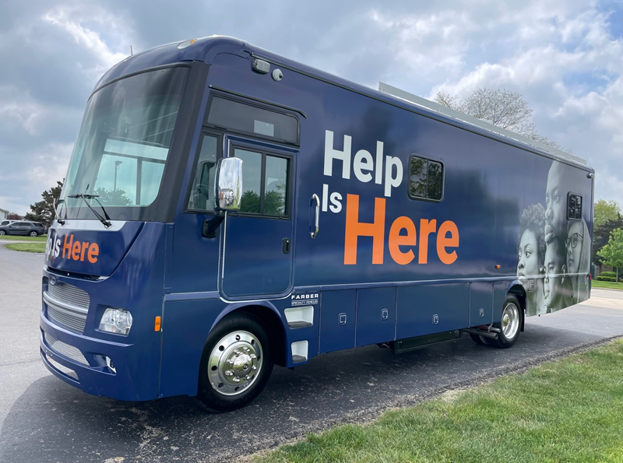
SPECIAL PROJECTS AND UPCOMING INITIATIVES
Notes:
Erika

Slide 37
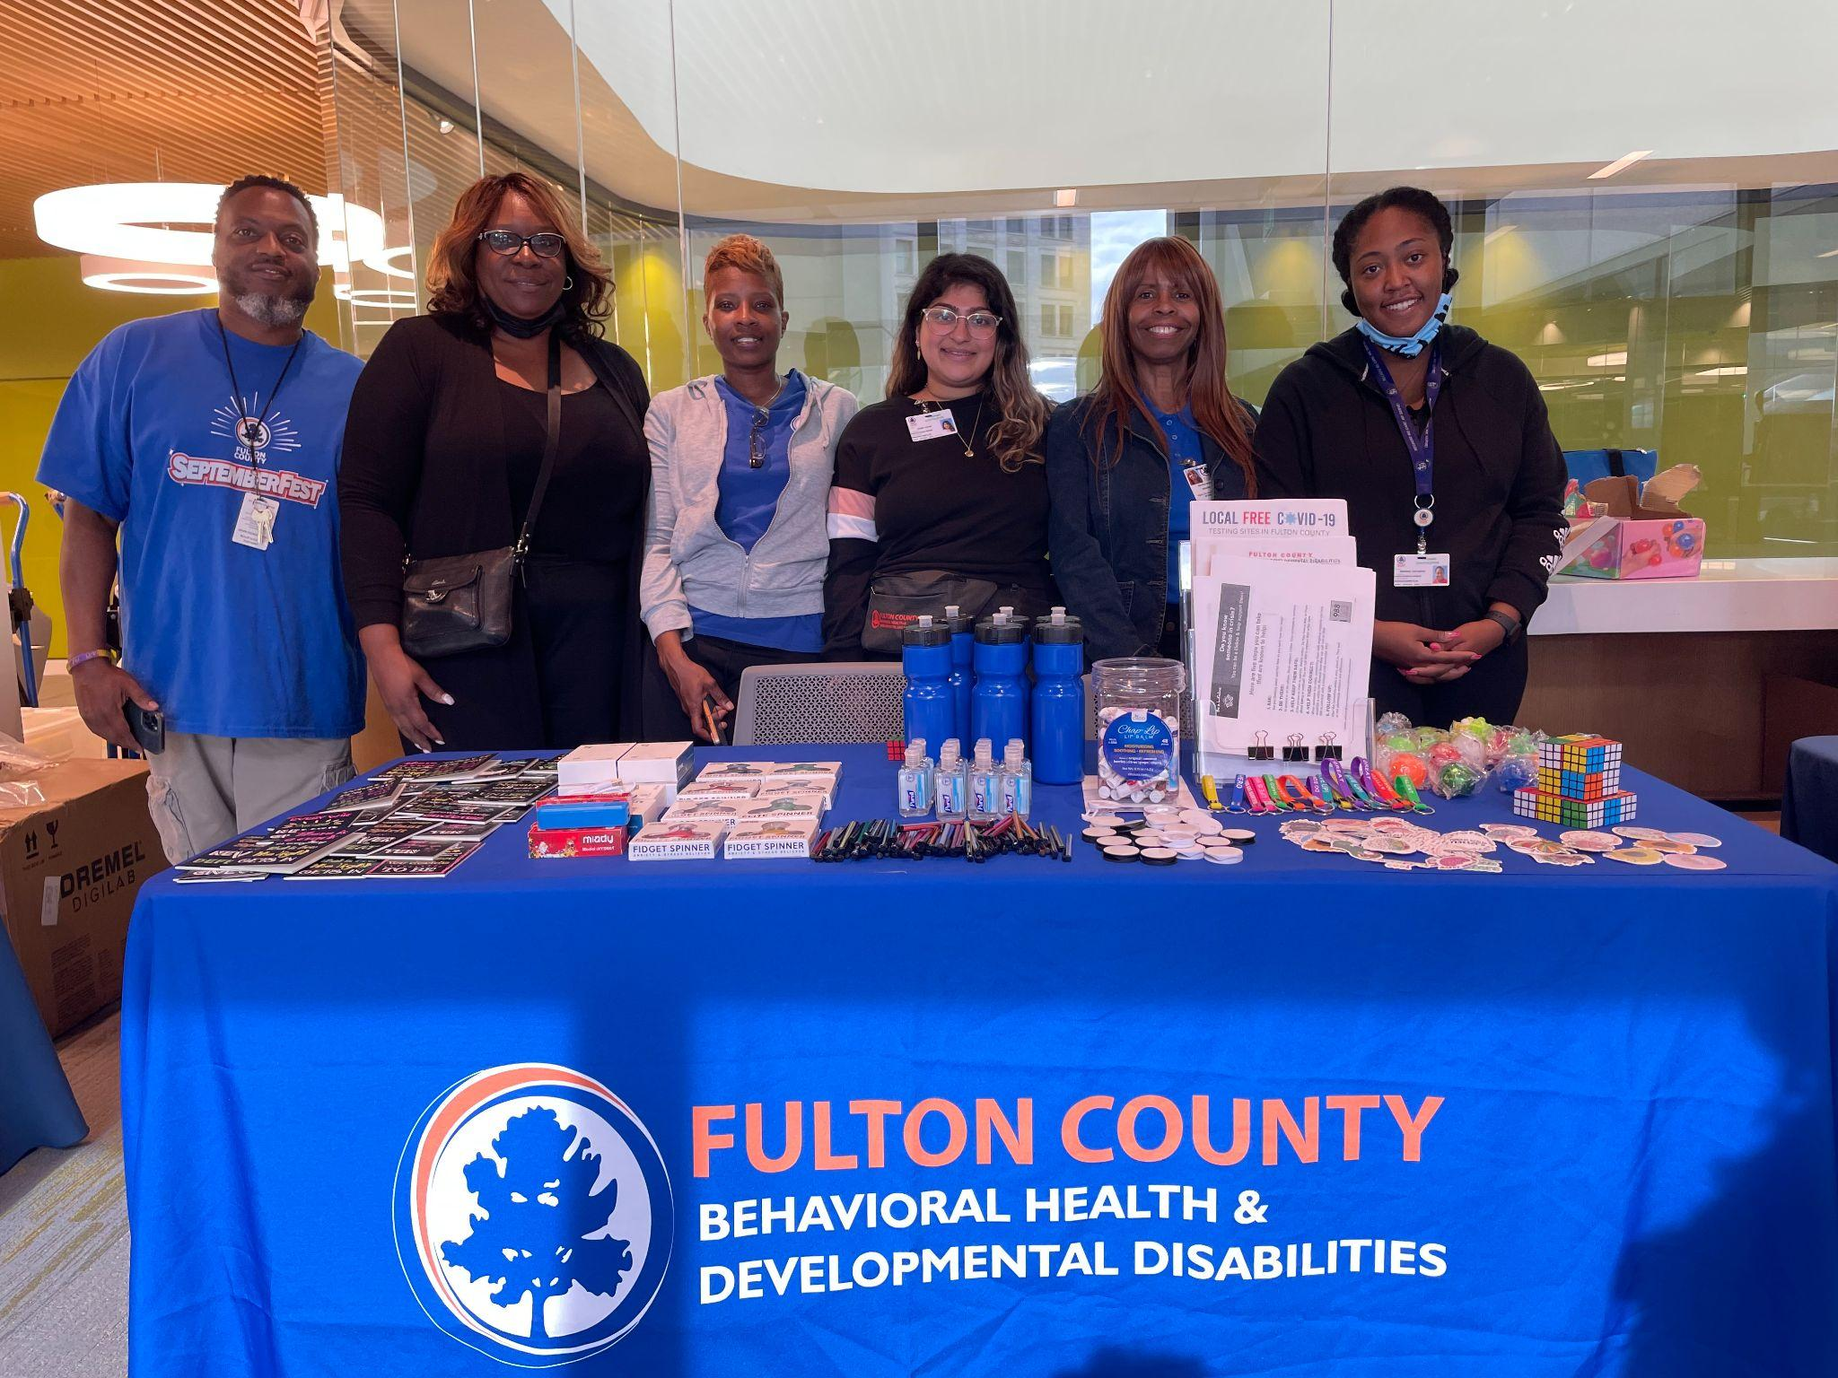
Community Outreach – Advancing Health Literacy Grant
July 1, 2021 – June 30,2024
Fulton County Dept of Behavioral Health & Developmental Disabilities was awarded a $3.9 million grant from the US Department of Health & Human Services
Purpose: Encourage COVID mitigation efforts and access to behavioral health services among racial and ethnic minorities & other vulnerable communities.
In Collaboration with:
  Fulton County Board of Health
  Morehouse School of Medicine
  Blk Cross Inc
  Department of External Affairs
Notes:
Erika

Slide 38

Community Outreach – Advancing Health Literacy Grant
The state-of-the-art vehicle features three private consultation rooms, telehealth services, interior and exterior monitors, a large screen television, a restroom, and wheelchair accessibility.
Information about mental illness, substance use disorders, COVID-19, and COVID-19 vaccinations and boosters that are recommended by the US Centers for Disease Control and Prevention (CDC)
Information about behavioral health services offered by the Fulton County Behavioral Health Network and assistance with accessing care
Assistance with scheduling an appointment at a Fulton County Behavioral Health Network location
Participation in events that promote preventive health measures, most specifically those offering COVID-19 and vaccine-related education
https://www.fultoncountyga.gov/behavioralhealthmobileunit
Notes:
Erika

Slide 39
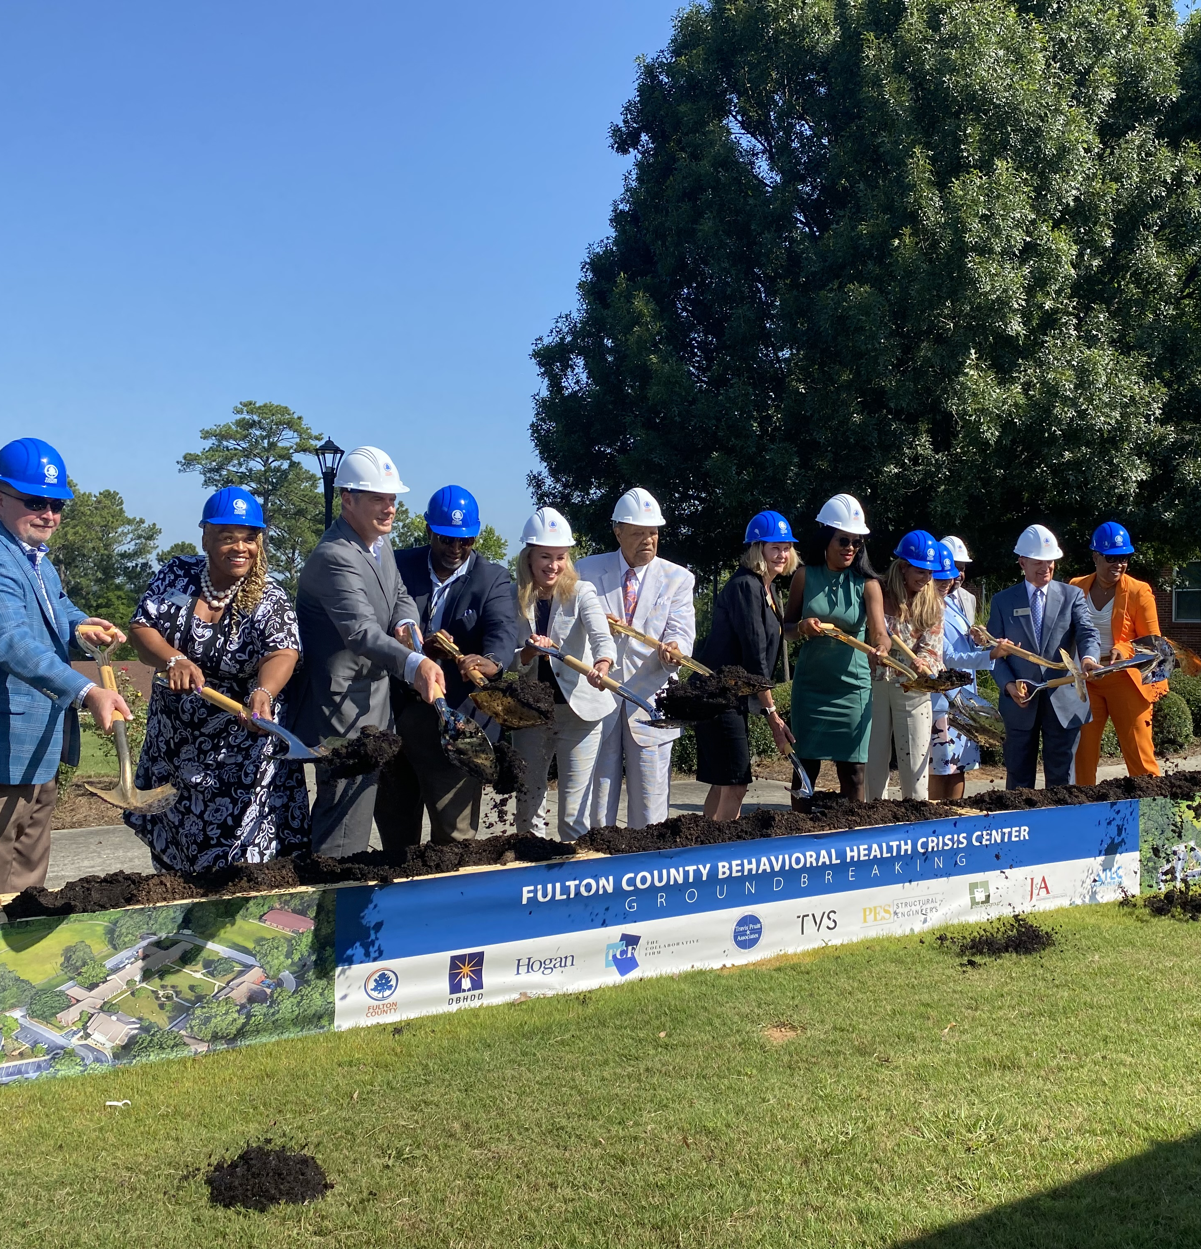
Happening in 2024
Behavioral Health Crisis Center
Slated for completion in Feb 2024
Crisis Center will provide services that include crisis intervention and stabilization services for adults.
Housed at Oak Hill, Child, Family and Adolescent Center: 2805 Metropolitan Pkwy SW, Atlanta, GA 30315
Facility will include 24 bed crisis stabilization unit with 16 observation chairs with enhanced entry based on the living room model.
Notes:
Afrika

Slide 40

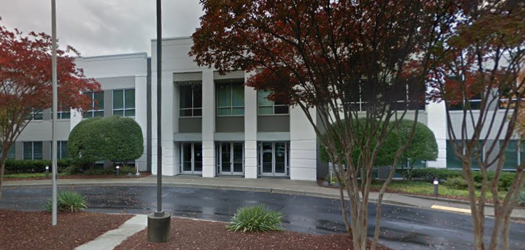




New Health & Human Services Location
Public Health
Behavioral Health and Developmental
Disabilities
DUI Services
Senior Services
4700 North Point Pkwy, Alpharetta GA
Potential Wrap-Around Services
Notes:
Afrika

Slide 41
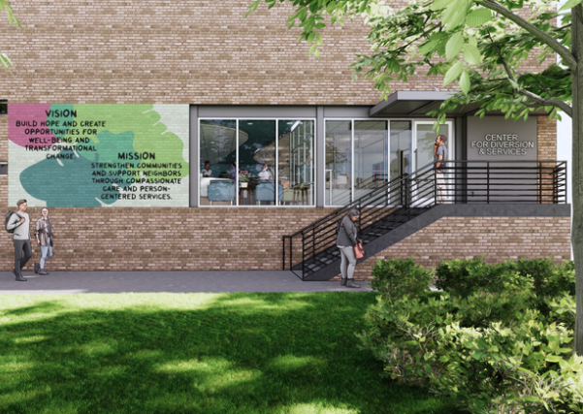
New The Center for Diversion & Services
The Center for Diversion & Services will provide alternatives to placing people in the County jail and City detention center who experience behavioral health concerns, substance abuse, and/or extreme poverty.
Complements other programs to reduce Fulton County jail population.
Atlanta Police Department & EMS will have 24/7 drop off access for low level , nonviolent offenses.

Slide 42
Happening in 2024: Grant Programming
  Youth Diversion
  The Fulton County Department of Behavioral Health and Developmental Disabilities (DBHDD), in partnership with the Fulton County Juvenile Court (FCJC) and Fulton County Schools (FCS), proposes this Youth Diversion Program (YDP) to provide early diversion services to 1,080 youth with a mental illness or co-occurring disorder (COD) who are involved with, or at risk of being involved with, the justice system. YPD will target middle/high school children aged 13-18 attending schools in South Fulton County, Georgia.
COSSUP Adult Diversion
Collaboration with Policing Alternatives and Division Initiatives (PAD)
Law enforcement and other first responder deflection and diversion.
Deflection. A DBHDD FDR mobile team will be responsible for conducting targeted outreach throughout Fulton County to deflect individuals experiencing homelessness and/or with SUD/COD before they reach justice system involvement.
PAD will accept referrals from The Center and provide an initial needs assessment, the Coordinated Entry housing assessment, intensive case management, linkages to community-based behavioral health supports, referrals for recovery housing, municipal IDs, benefits enrollment, legal aid, and additional support as needed.
Notes:
Afrika

Slide 43

JOINT COMMISSION ACCREDITATION
The Fulton County Department of Behavioral Health and Developmental Disabilities is accredited by Joint Commission
The Joint Commission is the recognized global leader for health care accreditation that offer unbiased assessment of our quality achievement in patient care and safety
Re-accreditation site visits occurs every 3 years
Reviews of organizational practices, policies and processes including: HR, Emergency Management, Environment of Care, Infection Control, Medication Management, Care, Treatment & Services, National Patient Safety Goals, Information Management, Leadership, Record of Care, etc.
Notes:
Erika

Slide 44
Questions and Answers
Notes:
Lynnette

Slide 45
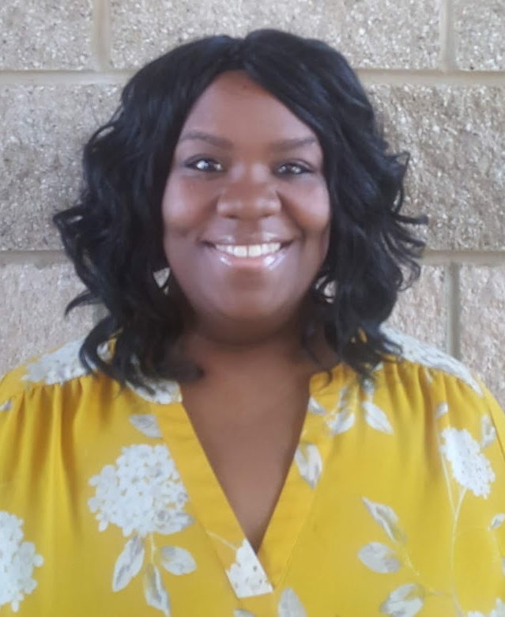
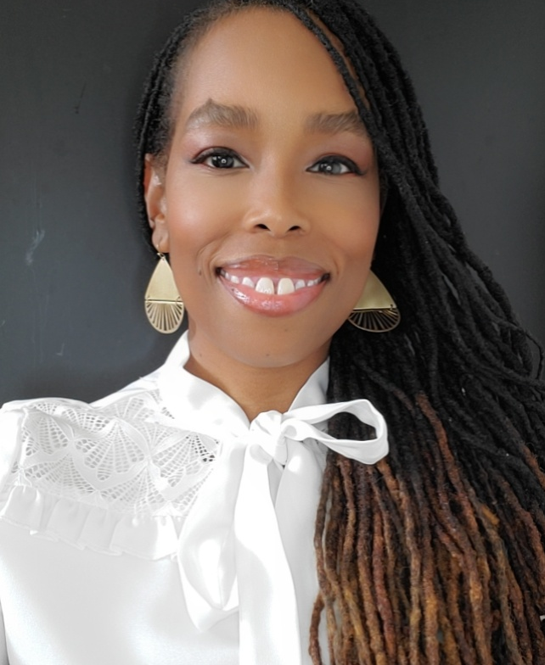
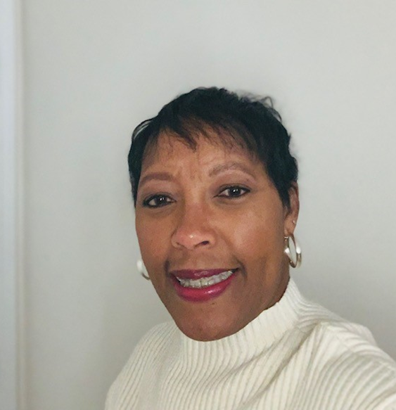
Contact Us!
Outpatient CORE Child, Adolescent & Adults
IDD services
Clubhouse
Advancing Health Literacy Grant
Joint Commission
DUI
MMC
SRU
Re-Entry
Supportive Housing
**PAD
CLASS
School-based Therapy
Text 4 Help
HIV PREVENTION EDUCATION & SCREENING
OPIOID USE DISORDER TREATMENT
Erika Williams-Walker, LPC, CPM®
Program Manager- Behavioral Health
404.613.1053 (office)
404.612.1570 (e-fax)
Erika.Williams-Walker@fultoncountyga.gov
Afrika Cotton, LMSW, CPM®
Program Manager – Judicial Intersection & Supportive Housing
404.613.1005 (office)
Afrika.cotton@fultoncountyga.gov
Lynnette Allen, CPM®
Program Evaluation Specialist- Opioid Coordinator
404.612.3561 (office)
Lynnette.Allen@fultoncountyga.gov

