Slide 1
FULTON COUNTY LIBRARY SYSTEM

Slide 2
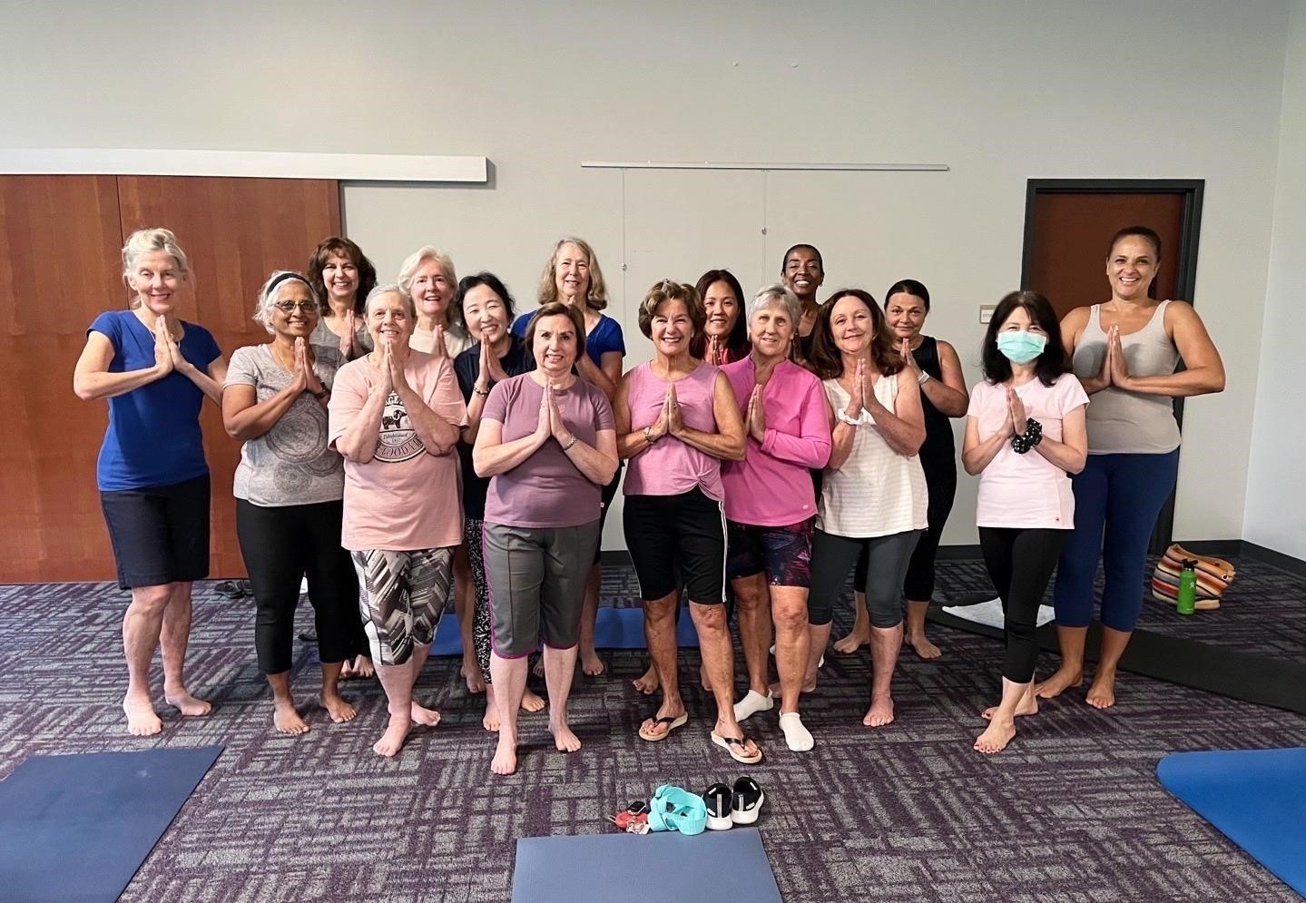
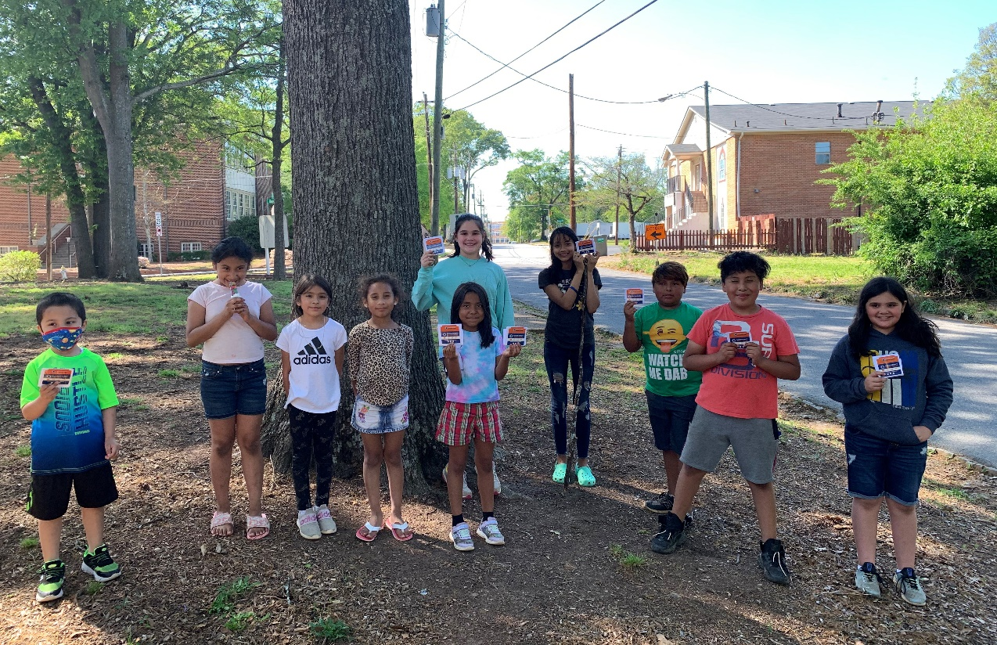
About FulcoLibrary
32 branch libraries, 1 library specializing in African American Culture and History and one Central/Library HQ
Serve all Fulton County residents of all ages
Offer free services including, books, movies, music, passes for local attractions, digital library services, programs for all ages, special services for students (CLASS Pass), tech services, computer labs, meeting and study rooms and so much more.

Slide 3
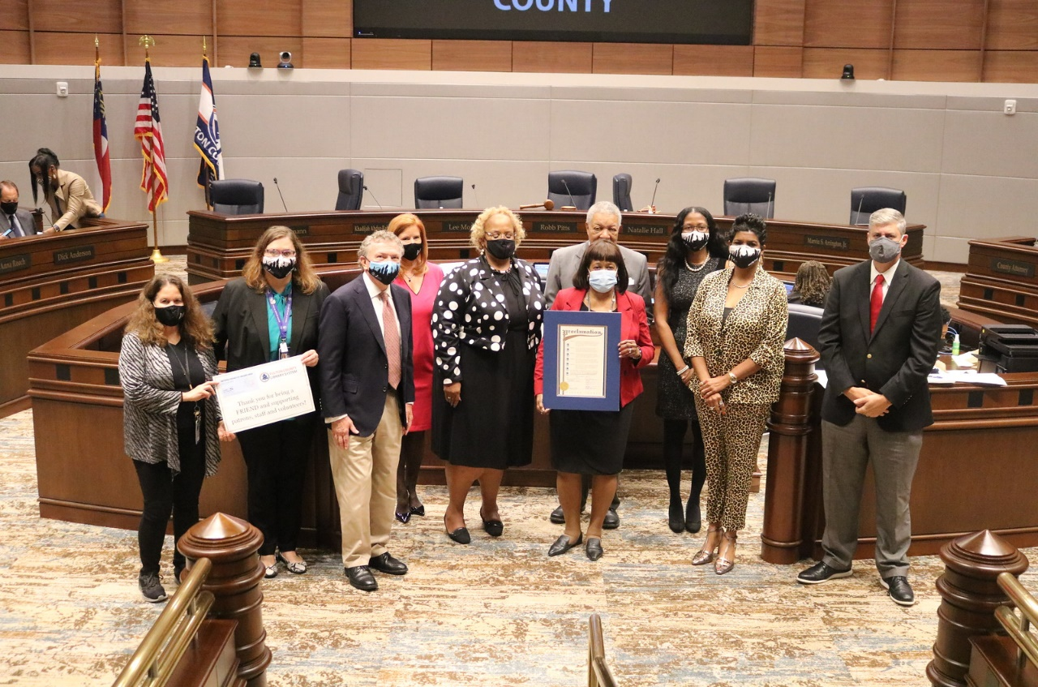
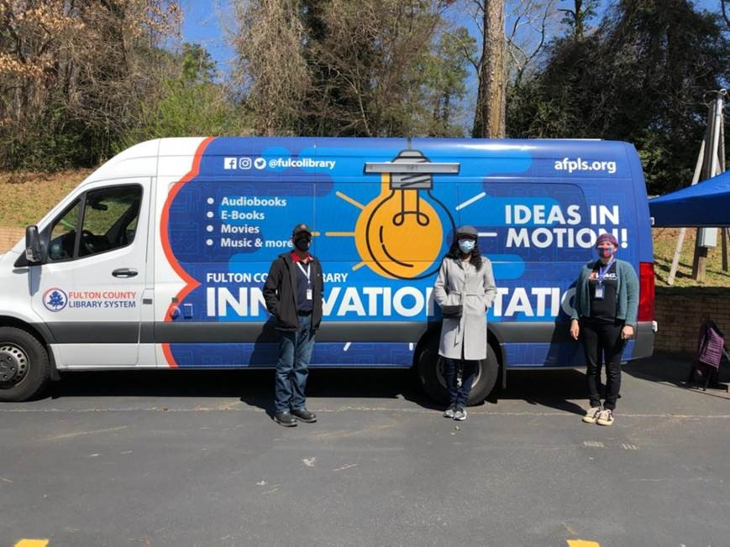
We have several departments we’ll hear from tonight
Director/Strategic Plan
Technical Services/Collection Management
Youth Services
Adult Services/Volunteer Services
Central Library
Auburn Avenue Research Library
Outreach Services
Social Services
Finance
Courier/HR Services
Marketing

Slide 4
DIRECTOR – Gayle Holloman

Slide 5
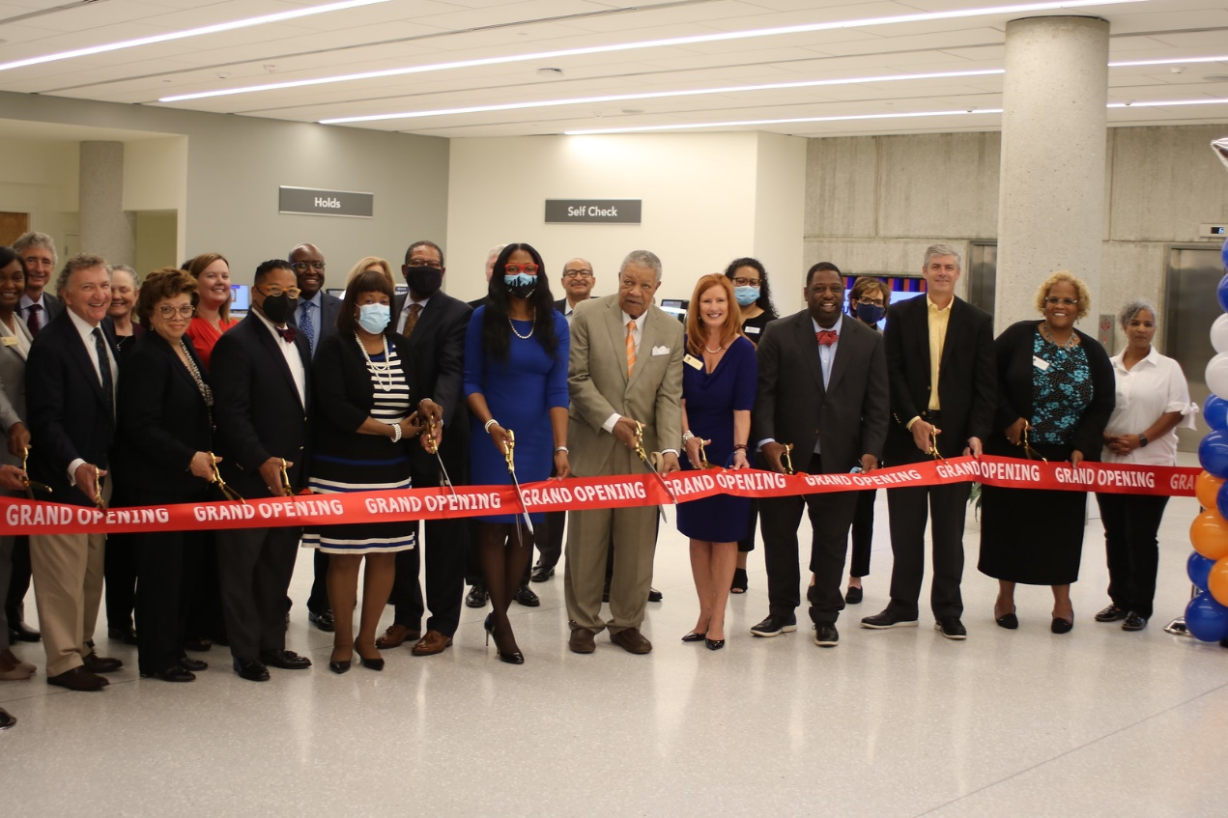
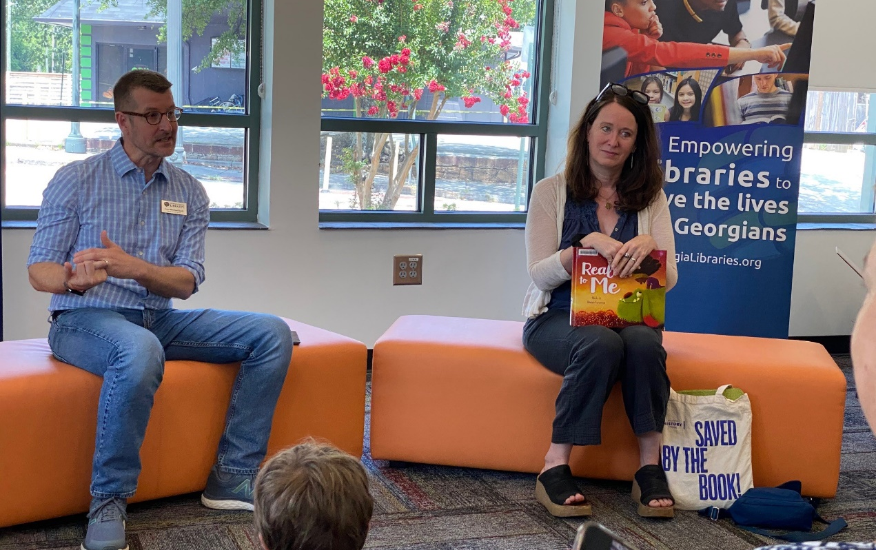
Director’s Overview
Responsible for the oversight of 34 libraries and nearly 300 employees
Works with the Library Board of Trustees to set policy for the system
Works with the Library Foundation and community partners to support the library system
Implements the goals of the 2022-2025 strategic plan

Slide 6
What is the Strategic Plan?

Slide 7
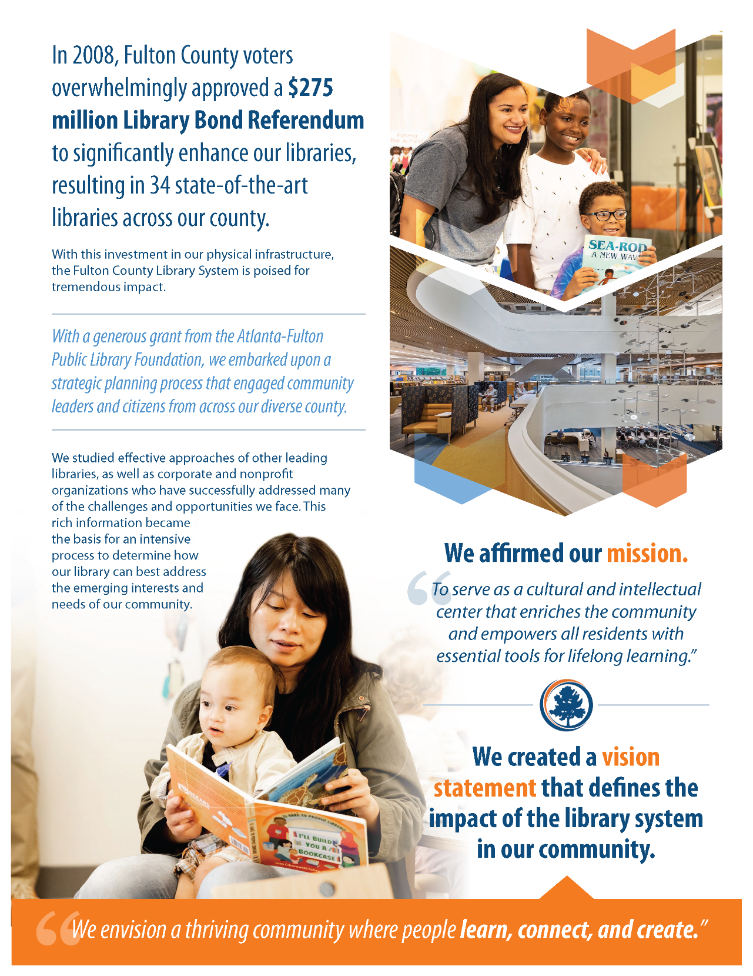
Where we’ve been …

Slide 8
Where we’re going …

Slide 9
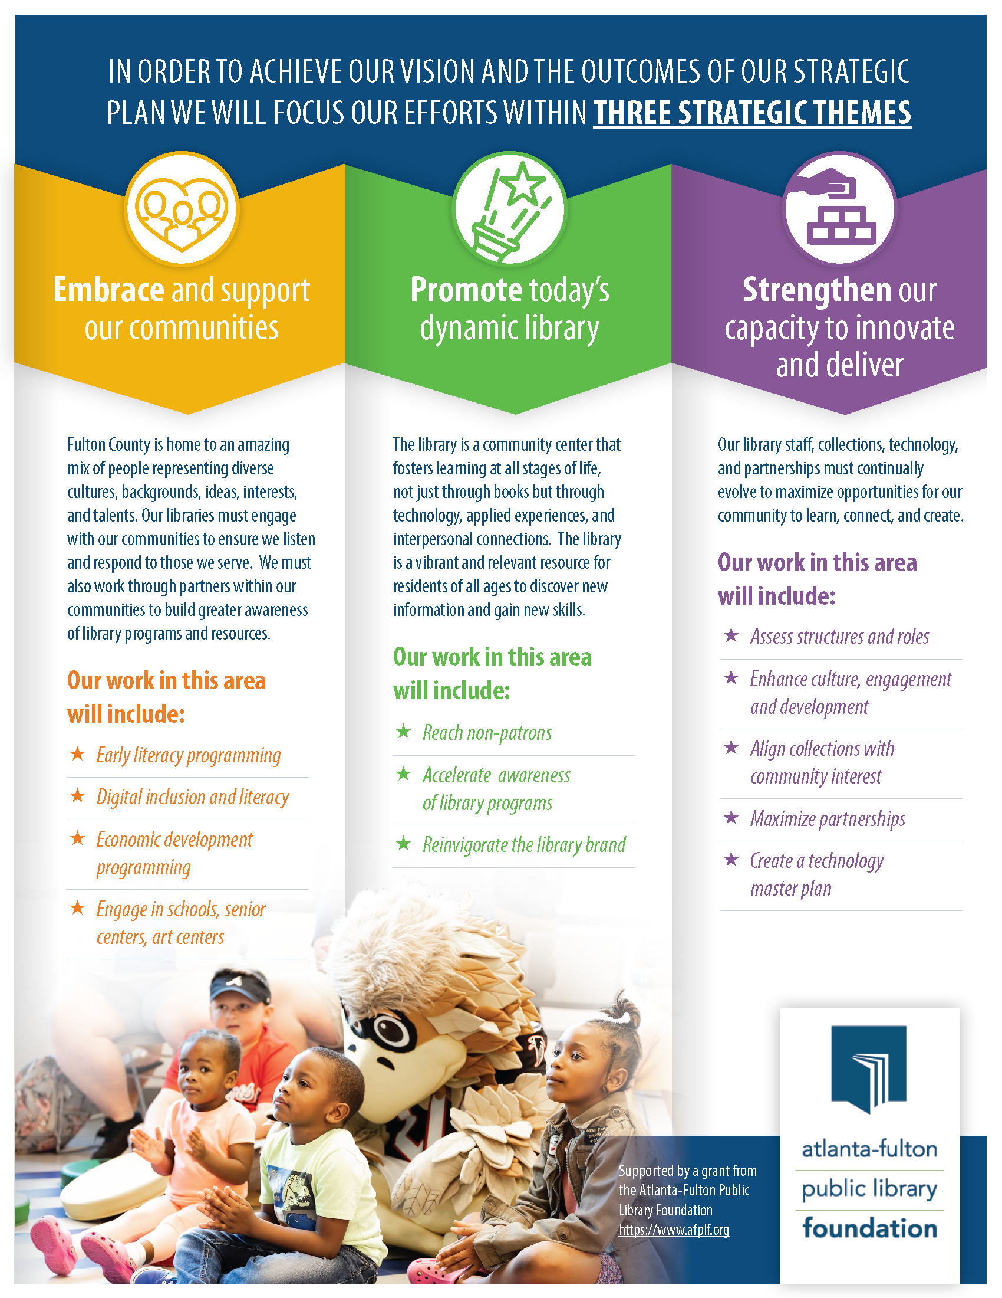
How we’ll get there

Slide 10
Technical Services – Brazos Price

Slide 15
Youth Services – Marcia Divack

Slide 19
Adult/Volunteer Services – Teryn Gilliam

Slide 25
Central Library – Cheryl Small

Slide 26
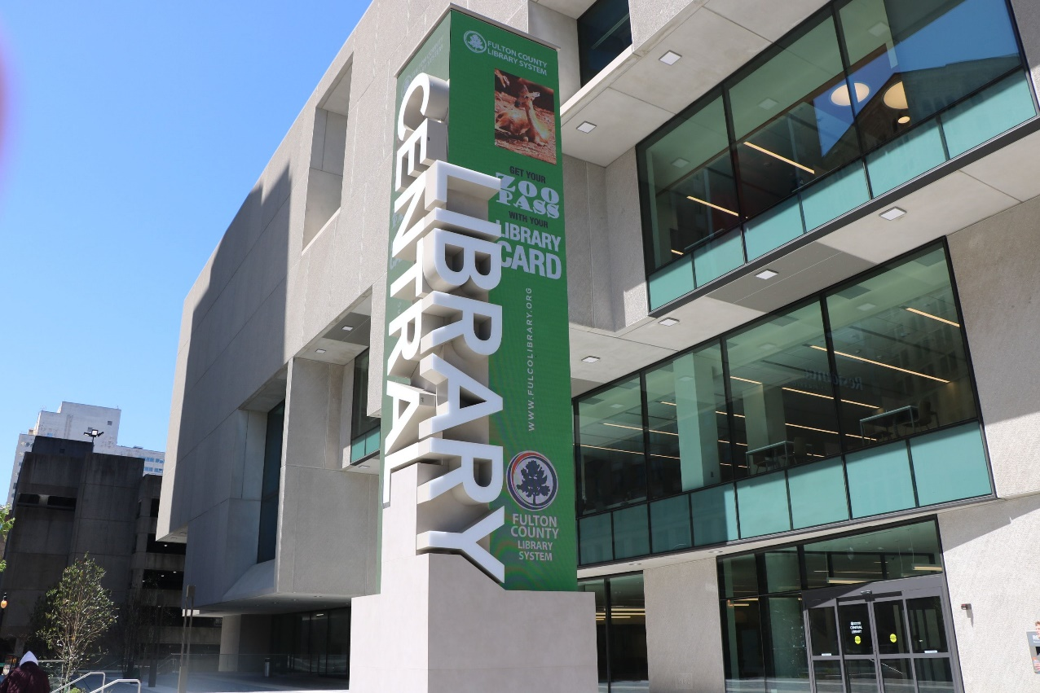
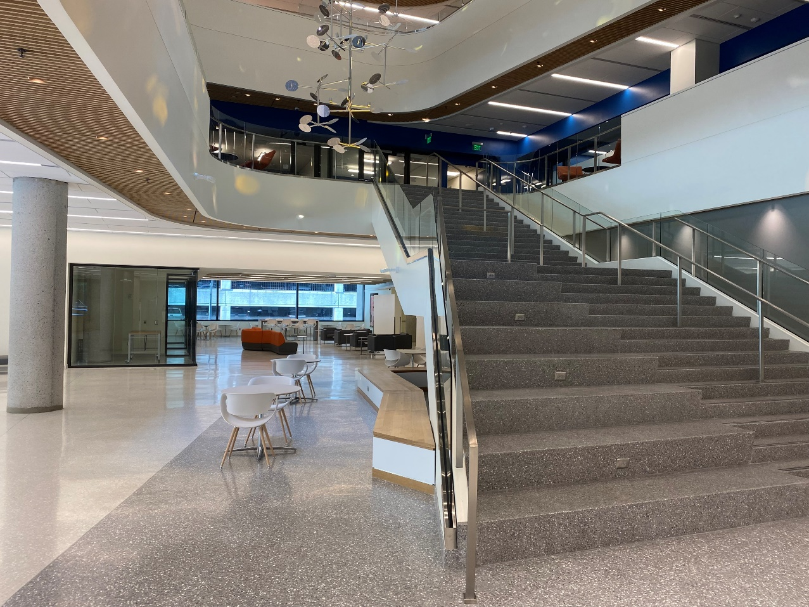
Central Library
Headquarters for the Library System
The largest significant facility – houses several departments and offers various services offered.
Basement
Gallery Space
1st Floor
Artist in Residency Spaces
GLS – Georgia Library Service for the blind and print disabled.
2nd Floor
GED
Computers
ESL and GED Classes

Slide 27
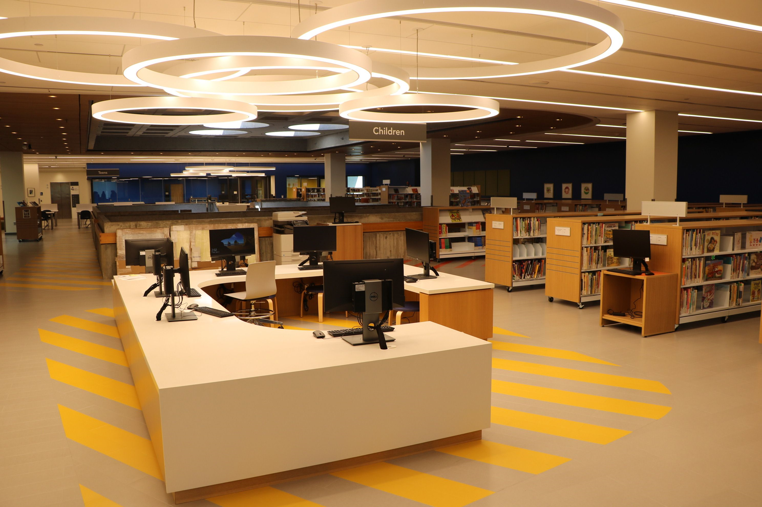
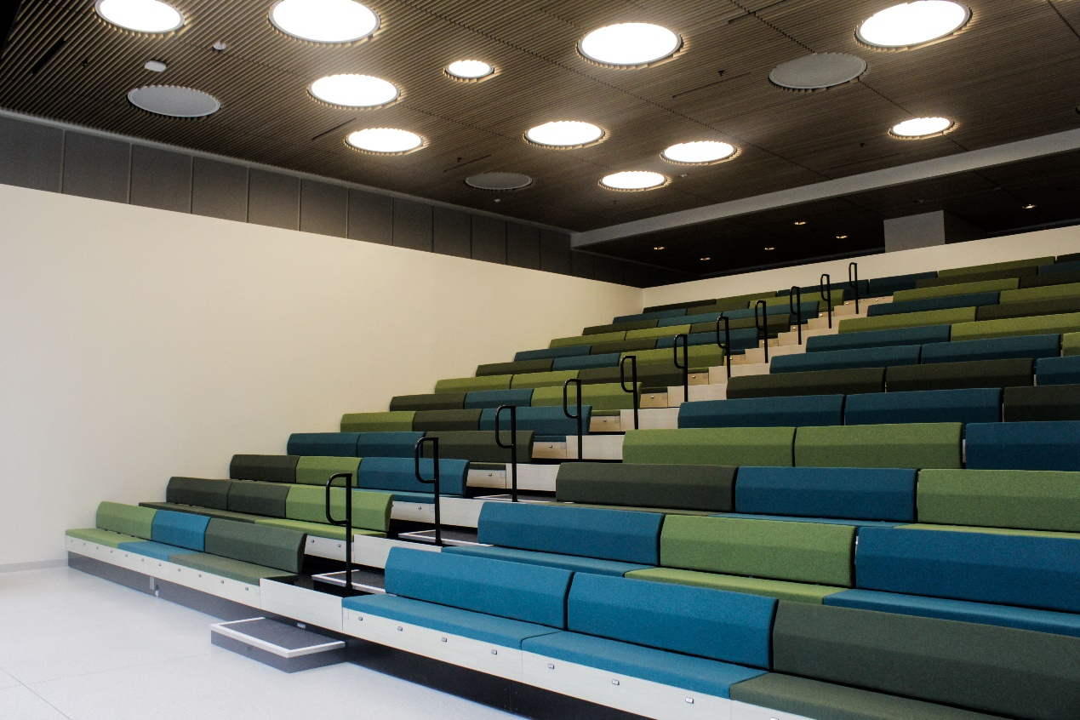
Central Library
3rd Floor – General Collections
Special Collections
Local History
Margaret Mitchell Collection
Haines Criss Cross Directory
Periodical Room
4th Floor – Youth Services
Children’s Department
Teen Department
Teen Tech Center
5th Floor Event Space
Auditorium
Six meeting rooms
Demo Kitchen
Catering Kitchen

Slide 28
Auburn Avenue – Victor Simmons

Slide 31
Outreach Services – Nicolas Rodriguez

Slide 35
Social Services – Jovita Fenwick

Slide 40
Finance Services – Jamar Parker

Slide 45
Courier/HR – Kimberly Snoddy-George

Slide 49
PR/Marketing– Claudia Strange

Slide 50
PR/Marketing
Manage all the grand opening celebrations of all libraries after renovation, and renaming ceremonies
Create quarterly Library Access magazine for the public
Create and distribute bi-weekly enewsletter to patrons
Film and produce the Library Access TV show on FGTV and YouTube
Record and produce the Checking Out FulcoLibrary Podcast
Support all signature programs including Summer Reading, One Book One Read, Children’s Book Festival and Library Card Signup Month, among others.

Slide 51
PR/Marketing
Responsible for the marketing and promotions for 34 libraries
Team of three staff including a graphic designer, video designer/photographer
Manage Social Media accounts for the system including Facebook, X (formerly Twitter), Instagram, YouTube, and LinkedIn
Responsible for design of flyers, posters, postcards, bookmarks, signage (including digital) for all branches
Create content for fulcolibrary.org website

Slide 52
QUESTIONS?

